Slide 1


NATIONAL SENIOR CERTIFICATE EXAMINATIONS
Results of the Class of 2020
Technical Briefing
Mr HM Mweli
Director-General
22 February 2020

Slide 2



PRESENTATION OUTLINE
Introduction
Size and Shape of the Sector
Class of 2020
Learner Support for Class of 2020
Size and Scope of the NSC Examination
Standardisation
Historical Trends
Overall National Results
NSC Passes by Qualification Type
Progressed Learners
School Performance by Quintile
Subject Performance
District Performance
Special Needs Education
Distinctions
Social Grants
Correctional Services
Performance of Part Time Candidates
Summary of Achievements
Conclusion

Slide 3
INTRODUCTION

Slide 4
INTRODUCTION
“By 2030, South Africans should have access to education and training of the highest quality, leading to significantly improved learning outcomes. The performance of South African learners in international standardised tests should be comparable to the performance of learners from countries at a similar level of development and with similar levels of access.”
National Planning Commission: National Development Plan, November 2011)

Slide 5
SIZE & SHAPE OF THE BASIC EDUCATION
SECTOR

Slide 6
BASIC EDUCATION SECTOR
Department of Basic Education (national)
Provincial Education Departments (9)
Education Districts (75)
Circuit Offices (889)
Schools (25 199)
Public schools (23 004)
Independent (Private) schools (2195)
Section 20 Public schools
Section 21 Public Schools (former Model C)
Registered independent schools
Unregistered independent schools (illegal)
Greater financial autonomy
Non-subsidised independent schools
Subsidised independent schools

Slide 7
NUMBER OF LEARNERS, EDUCATORS AND SCHOOLS IN THE ORDINARY SCHOOL SECTOR BY PROVINCE, IN 2020
Province | PUBLIC |  |  | INDEPENDENT |  |  | PUBLIC AND INDEPENDENT
 | Learners | Educators | Schools | Learners | Educators | Schools | Learners | As % of National | Educators | As % of National | Schools | As % of
 |  |  |  |  |  |  |  | Total |  | Total |  | National Total
EC | 1 768 040 | 59 279 | 5 213 | 75 257 | 3 368 | 239 | 1 843 297 | 14 | 62 647 | 14 | 5 452 | 22
FS | 700 052 | 22 539 | 1 045 | 19 795 | 1 163 | 77 | 719 847 | 5 | 23 702 | 5 | 1 122 | 4
GT | 2 186 156 | 69 719 | 2 071 | 322 231 | 19 678 | 834 | 2 508 387 | 19 | 89 397 | 20 | 2 905 | 12
KZN | 2 808 976 | 92 800 | 5 853 | 58 295 | 3 898 | 338 | 2 867 271 | 22 | 96 698 | 22 | 6 191 | 25
LP | 1 686 170 | 50 352 | 3 716 | 73 152 | 3 246 | 170 | 1 759 322 | 13 | 53 598 | 12 | 3 886 | 15
MP | 1 079 687 | 35 062 | 1 666 | 28 203 | 1 756 | 116 | 1 107 890 | 8 | 36 818 | 8 | 1 782 | 7
NC | 297 669 | 10 037 | 545 | 6 568 | 490 | 40 | 304 237 | 2 | 10 527 | 2 | 585 | 2
NW | 839 859 | 26 296 | 1 447 | 23 212 | 1 365 | 85 | 863 071 | 7 | 27 661 | 6 | 1 532 | 6
WC | 1 176 810 | 36 768 | 1 448 | 66 340 | 5 124 | 296 | 1 243 150 | 9 | 41 892 | 9 | 1 744 | 7
South Africa | 12 543 419 | 402 852 | 23 004 | 673 053 | 40 088 | 2 195 | 13 216 472 | 100 | 442 940 | 100 | 25 199 | 100

Slide 8
EDUCATION STATISTICS AT A GLANCE, 2020
Size of the Schooling System:
Learners: 12 543 419
Educators: 442 940
Schools: 25 199
Official languages
English, isiZulu, isiXhosa, isiNdebele, Afrikaans, siSwati, Sepedi, Sesotho, Setswana, Tshivenda, Xitsonga
Sector | Learners | Educators | Schools
Public | 12 543 419 | 402 852 | 23 004
Independent | 673 053 | 40 088 | 2 195
Total | 13 216 472 | 442 940 | 25 199

Slide 9
IMPACT OF COVID-19 ON THE SECTOR

Slide 10
IMPACT OF COVID-19
“During the coronavirus disease (COVID-19) pandemic, prolonged school closures may result in a reversal of educational gains, limiting children’s educational and vocational opportunities as well as their social and emotional interactions and development. The longer a student stays out of school, the higher the risk of dropping out.1 Additionally, students who are out of school – and particularly girls – are at increased risk of vulnerabilities (e.g. subject to greater rates of violence and exploitation, child marriage and teenage pregnancy).1,2,3 Furthermore, prolonged school closures interrupt and disrupt the provision of, and access to, essential school-based services such as school feeding and nutrition programmes, immunization, and mental health and psychosocial support (MHPSS).”
World Health Organisation (WHO), 2020

Slide 11

MAIN RESEARCH QUESTIONS
What did school attendance rates look like after reopening?
How much learning has been lost?
How worried were adults living with children about their return to school during a pandemic?
How ready were schools to receive returning learners?
What is the objective health risk of reopening schools?
What were the other costs of school closure?
Notes:
It is in this context of phased school return that we investigate the impact of COVID-19 on the basic education sector from July – August 2020 using Wave 2 of the NIDS-CRAM and DBE monitoring data, specifically asking

Slide 12
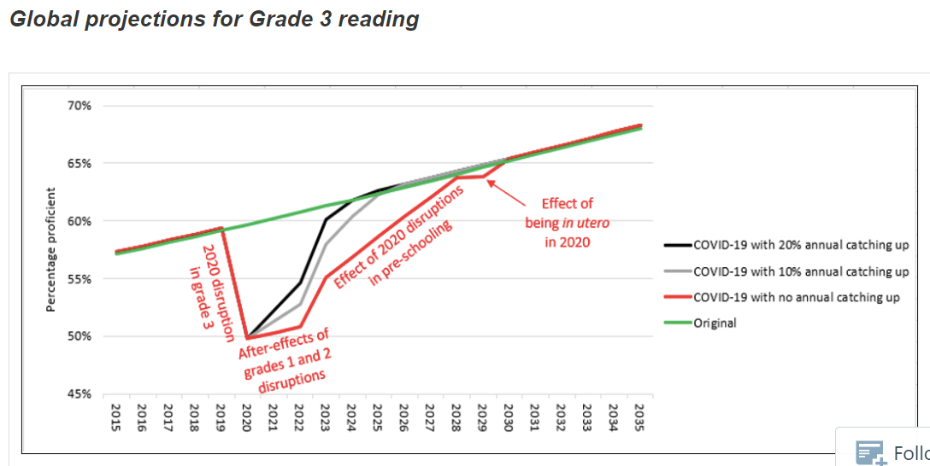
How serious are the learning losses?
The key factor we should not forget: FORGETTING!
Losing 40% of the school year means losing more than 40% of a year of learning.
Grade 12
2032

Slide 13
Hospitalisations
Hospitalisations per week have risen with the second wave (grey curve, numbers on the right).
But numbers for children remain low, e.g. around 25 hospitalisations per week for those aged 5 to 9, also 10 to 14. These numbers have barely changed.
The percentage of all hospitalisations in a particular age group has not changed significantly over the Aug to Dec period.
Probabilities for children remain low. E.g. someone aged 50 to 54 is 76 times as likely to be hospitalised as someone aged 5 to 9.

Slide 14
Deaths
Deaths per week have risen with the second wave (grey curve, numbers on the right).
But numbers for children remain low, e.g. around 0.6 deaths per week for those aged 5 to 9, also 10 to 14. These numbers have barely changed.
The percentage of all deaths in a particular age group has not changed significantly over the Aug to Dec period.
Probabilities for children remain especially low. E.g. someone aged 50 to 54 is 856 times as likely to die as someone aged 5 to 9.

Slide 15
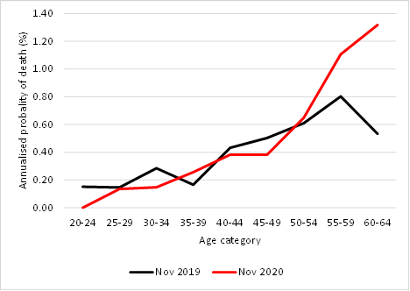
HIGHER MORTALITY RATES FOR TEACHERS?

Slide 16
SCHOOL ATTENDANCE
13

Slide 17
2020 SCENARIO
School closures have played a significant role in the global response to reducing COVID-19 spread.
  In April 2020, 193 countries had closed schools; by June this number had fallen to 112, and by September 46 (UNESCO, 2020)
After schools closed in SA on 18 March, a phased reopening was adopted by the government.
Deviation permitted based on school’s ability to comply with guidelines and approval by provincial HoD.
Schools have been and will continue to operate under various types of rotational timetabling.
June
July
August
Grades
7 & 12
+ Grades
R, 6 & 11
Grade 12 (3rd )
+ Grade 7 (10th)
+ Grades R-4, 6-7, 9-11 (24th)
+ Grades 5 & 8 (31st)
14

Slide 18
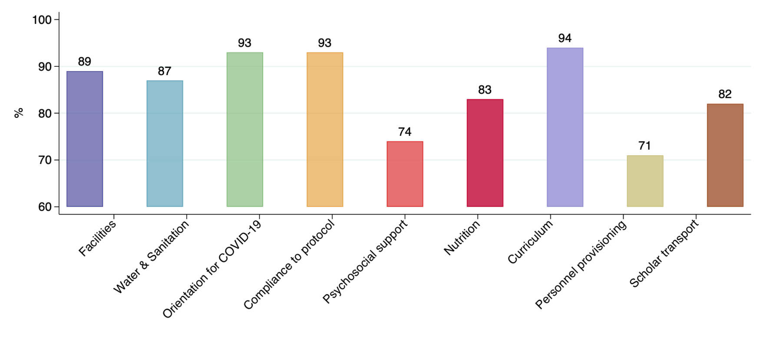
School readiness: by thematic area
Levels of readiness were higher in all 9 sections of the monitoring tool compared to a similar exercise in June.
Note: Source is not NIDS-CRAM but a different DBE sample (non representative) of 611 schools (excl. WC), observed between 1-10 July.
Notes:
School readiness index based on 54 “Yes/No” questions grouped into nine thematic areas; each item and thematic area were weighted equally. Biggest improvements seen in curriculum and orientation to new protocols).

Slide 19
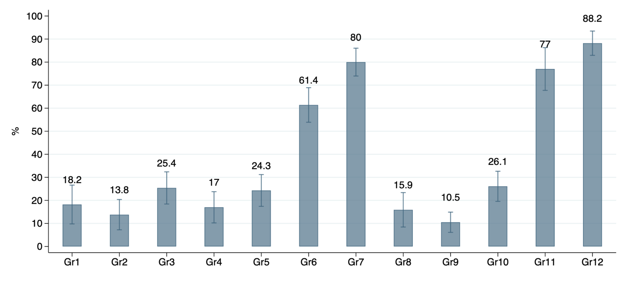
Attendance: overall
Absence in normal times = 2% (GHS, 2018)
Officially “open”
Officially “open”
In a different DBE sample (non representative) of 611 schools (excl. WC), principals reported average “open grade” absenteeism between 1-10 July of 17%
“not yet open”
“not yet open”

Slide 20
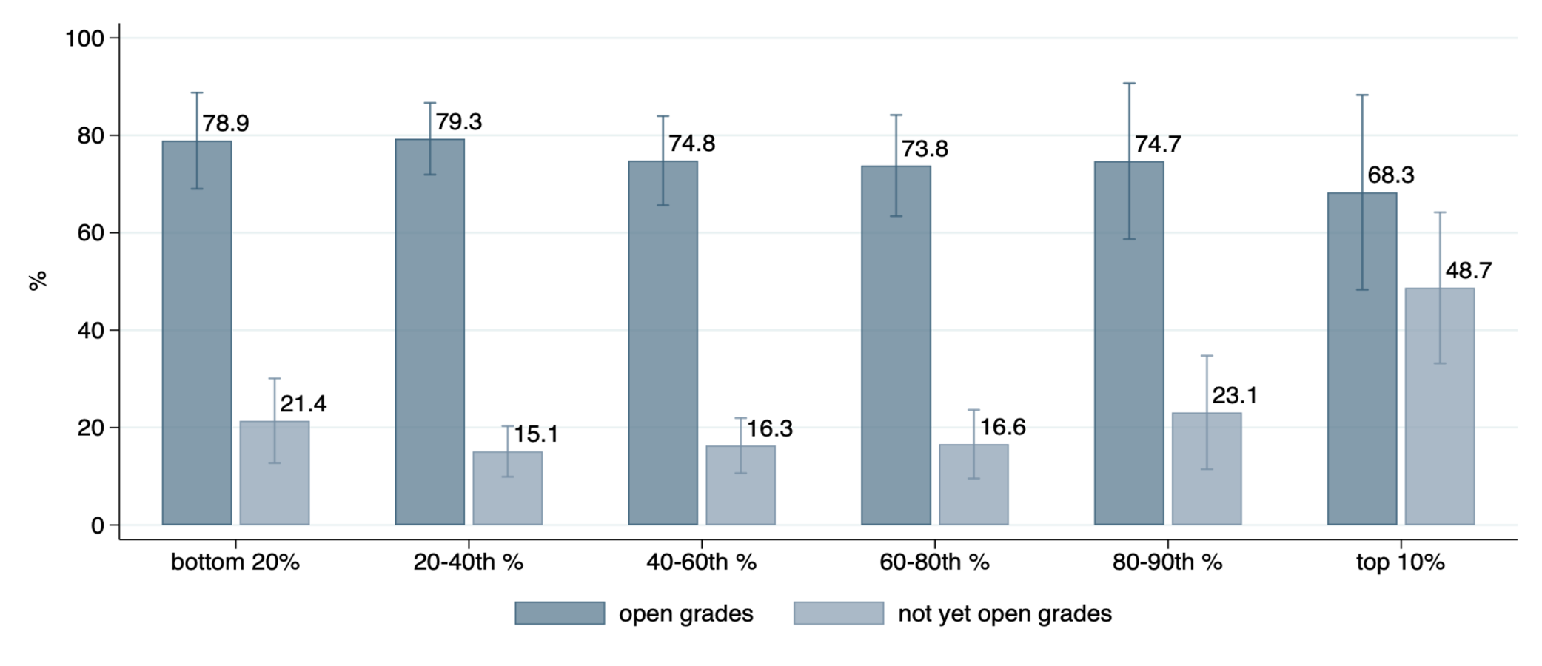
Attendance: by household per capita quintile/decile
By November, when all grades were “open”, attendance was high across all socio-economic groups
Notes:
Note: bracket response used for approx. 30% of households, and 18% non-response imputed using lower-bound estimate of Jain et al (2020)

Slide 21
PERCEPTIONS ON SCHOOL RETURN
72.6% of respondents very worried about learner return to school during pandemic
58.6% of respondents to a StatsSA online survey conducted in last 2 weeks of June said it was not safe to return to school; most people’s reason given was health risk to children.
Notes:
The question of how to reopen schools is not just a scientific and technocratic one, but also an emotional one (Levinson et al, 2020). Limited research has been conducted on adult and parent perceptions of schooling under the COVID-19 pandemic; mostly from the United States

Slide 22
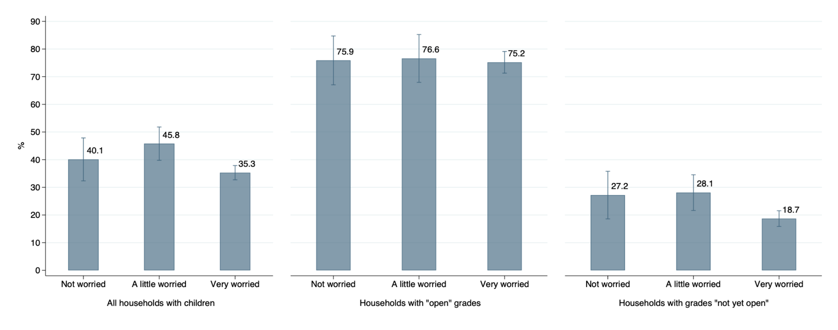
PARENT PERCEPTIONS ON SCHOOL RETURN (LEVEL OF WORRY) & ATTENDANCE

Slide 23
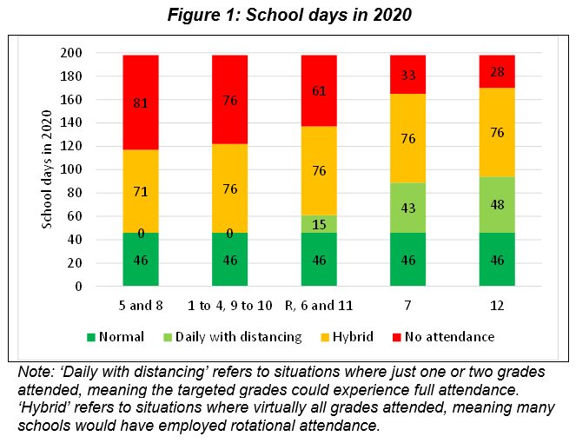
THE 2020 SCHOOL YEAR IN A NUTSHELL
This implies 60% of the school year lost.

Slide 24
SUMMARY AND RECOMMENDATIONS
Main Findings:
Attendance rates have bounced back significantly since July when not all grades were open. But this ignores the effect of rotational timetabling which is resulting in further lost contact time
Attendance rates were relatively high despite high levels of worry
Children are still at substantially lower risk to COVID-19 than adults, especially young children
Recommendations:
Schools should remain open as far as possible, with all precautionary mechanisms in place, and priority given to early grades if a phased approach is needed
Prioritize recovery of learning, which will also mitigate against dropout and other negative social impacts

Slide 25
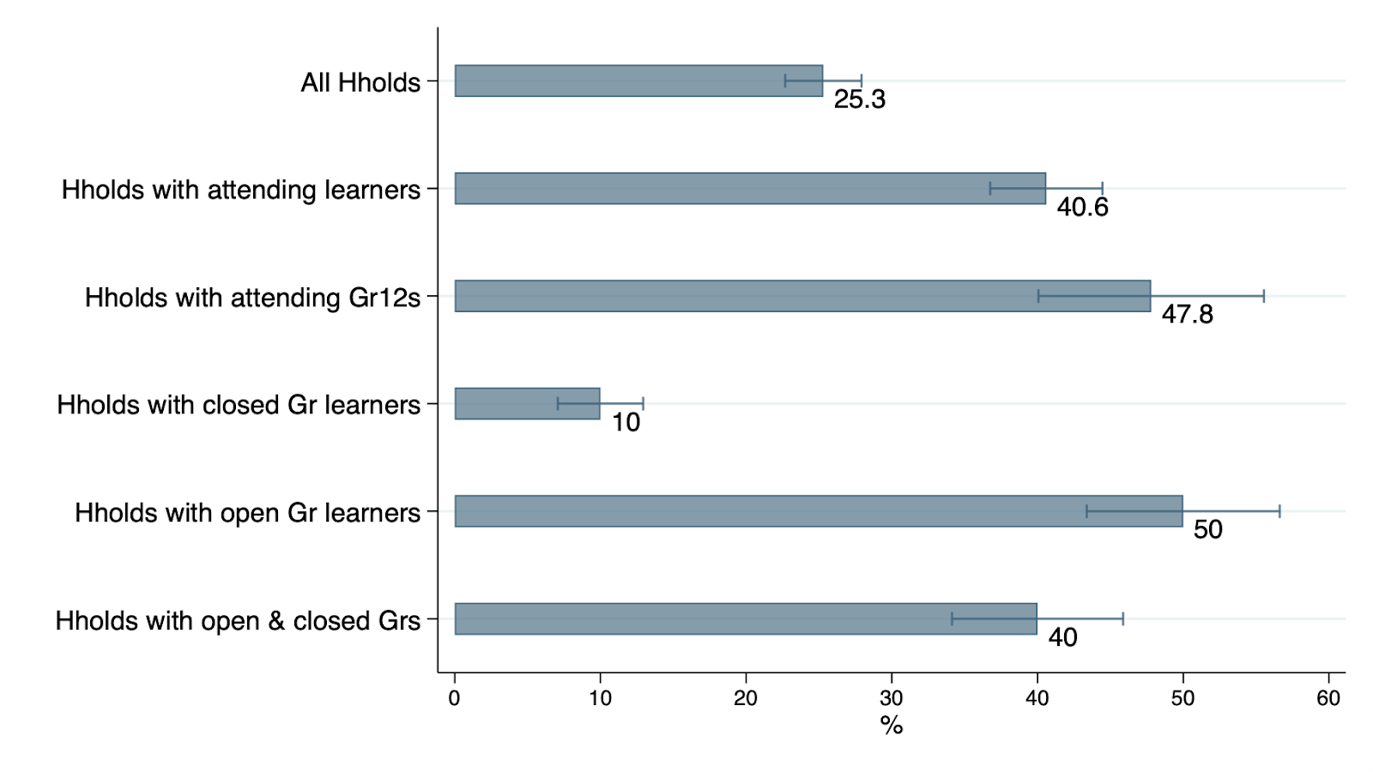
THE SOCIAL PROTECTION OFFERED BY SCHOOLS
Respondents living in households where a child received a meal at school in July
Notes:
approximately 80% of children benefit from the NSNP, estimated at 9.6 million meals a day, and that the coverage of this programme has expanded significantly over the years.

Slide 26
THE CLASS OF 2020

Slide 27
THE 2020 ACADEMIC YEAR
The year 2020, will be remembered as the year that not only presented a major health challenge, but a year when the entire world was held to ransom by COVID- 19.
The Class of 2020, that entered their Grade 12 year with high expectations, could in no way escape the ravages of COVID-19.
The Department of Basic Education (DBE) attempted to insulate the Grade 12 learners, and this has produced reasonable success.
However, loss of teaching and learning cannot be fully recovered.

Slide 28
2020 Unique Educational Context
Extended School closure
Need for Psycho-Social support
Learner absenteeism
Learning under COVID 19 conditions
Teacher absenteeism
Intermittent school closures

Slide 29
Profile of the Class of 2020
Seventh cohort to sit for the NSC based on CAPS
The Class of 2020 entered Grade 1 in 2009 and had 11 years of a fairly stable and conducive teaching and learning environment.
There has been a gradual improvement in the quality of School Based Assessment over the past few years.
Strong emphasis on formative school based assessment over the past few years.
Standard and quality of Public Examinations is on an ongoing improvement trajectory.
The COVID-19 pandemic posed unprecedented challenges to the Class of 2020

Slide 30
Profile of the Class of 2020
(g) This cohort was impacted by the following key policy changes:
Policy on Progression (7th cohort)
Discontinuation of the Policy on Multiple Examination Opportunity (MEO)
Introduction of Sign Language Home Language in 2018
Introduction of Specialisation in the Technology Subjects in 2018
Offering 2 question papers in Accounting and Business Studies
Abolishment of the designated list of subjects in 2018

Slide 31
THE STRENGTH OF THE 2020 CLASS BEFORE THE NOV/DEC NSC EXAMINATIONS

Slide 32
High Enrolment Subject Pass Rates
2017 Grade 10 vs 2018 Grade 10 (DDD Term 4 data)
2017 Gr 10 | 98,2% | 91,0% | 86,3% | 75,8% | 77,9% | 83,9%
2018 Gr 10 | 98,6% | 91,7% | 87,1% | 81,5% | 76,6% | 84,3%
Difference | 0,4% | 0,7% | 0,8% | 5,7% | -1,3% | 0,4%
34

Slide 33
High Enrolment Subject Pass Rates
2017 Grade 10 vs 2018 Grade 10 (DDD Term 4 data)
2017 Gr 10 | 72,3% | 82,2% | 74,3% | 78,0% | 74,1% | 46,2%
2018 Gr 10 | 73,0% | 85,1% | 75,6% | 80,4% | 73,3% | 43,8%
Difference | 0,7% | 2,9% | 1,3% | 2,4% | -0,8% | -2,4%
35

Slide 34
Home Language Subject Pass Rates
2018 Grade 11 vs 2019 Grade 11 (DDD Term 4 data)
2018 Gr 11 | 99,5% | 99,3% | 99,1% | 99,3% | 98,7% | 98,2%
2019 Gr 11 | 99,8% | 99,7% | 99,6% | 99,5% | 99,4% | 99,2%
Difference | 0,3% | 0,4% | 0,5% | 0,2% | 0,7% | 1,0%
37

Slide 35
Home Language Subject Pass Rates
2018 Grade 11 vs 2019 Grade 11 (DDD Term 4 data)
2018 Gr 11 | 98,4% | 98,7% | 98,4% | 97,1% | 95,8% | 95,8%
2019 Gr 11 | 99,1% | 99,1% | 98,5% | 97,3% | 96,5% | 94,4%
Difference | 0,7% | 0,4% | 0,1% | 0,2% | 0,7% | -1,4%
38

Slide 36
High Enrolment Subject Pass Rates
2018 Grade 11 vs 2019 Grade 11 (DDD Term 4 data)
2018 Gr 11 | 99,0% | 93,0% | 86,6% | 75,9% | 79,5% | 74,3%
2019 Gr 11 | 99,5% | 95,7% | 90,6% | 87,1% | 82,4% | 82,3%
Difference | 0,5% | 2,7% | 4,0% | 11,2% | 2,9% | 8,0%
39

Slide 37
High Enrolment Subject Pass Rates
2018 Grade 11 vs 2019 Grade 11 (DDD Term 4 data)
2018 Gr 11 | 76,8% | 71,2% | 74,6% | 73,9% | 69,0% | 45,3%
2019 Gr 11 | 81,6% | 80,4% | 79,6% | 78,4% | 72,7% | 50,7%
Difference | 4,8% | 9,2% | 5,0% | 4,5% | 3,7% | 5,4%
40

Slide 38
SUMMARY OF COMPARISONS
The key findings of the analysis include:
The 2019 Grade 11s (2020 Grade 12 cohort proxy) outperformed the 2018 Grade 11s (2019 Grade 12 cohort proxy) in:
10 out of 11 home language subjects, and
12 out of 12 high enrolment subjects based on final year subject pass rates.
The 2018 Grade 10s (2020 Grade 12 cohort proxy) outperformed the 2017 Grade 10s (2019 Grade 12 cohort proxy) in:
8 out of 11 home language subjects, and
8 out of 12 high enrolment subjects based on final year subject pass rates.
Notes:
Based on Term 1 data, the 2020 Grade 12 class had a higher proportion of stronger performing learners compared to the 2019 Grade 12 class. This is evidenced by the proportion of Grade 12 learners that were progressed from Grade 11 decreasing from 21% to 16% between 2019 and 2020.

Slide 39
LEARNER SUPPORT FOR THE CLASS OF
2020

Slide 40
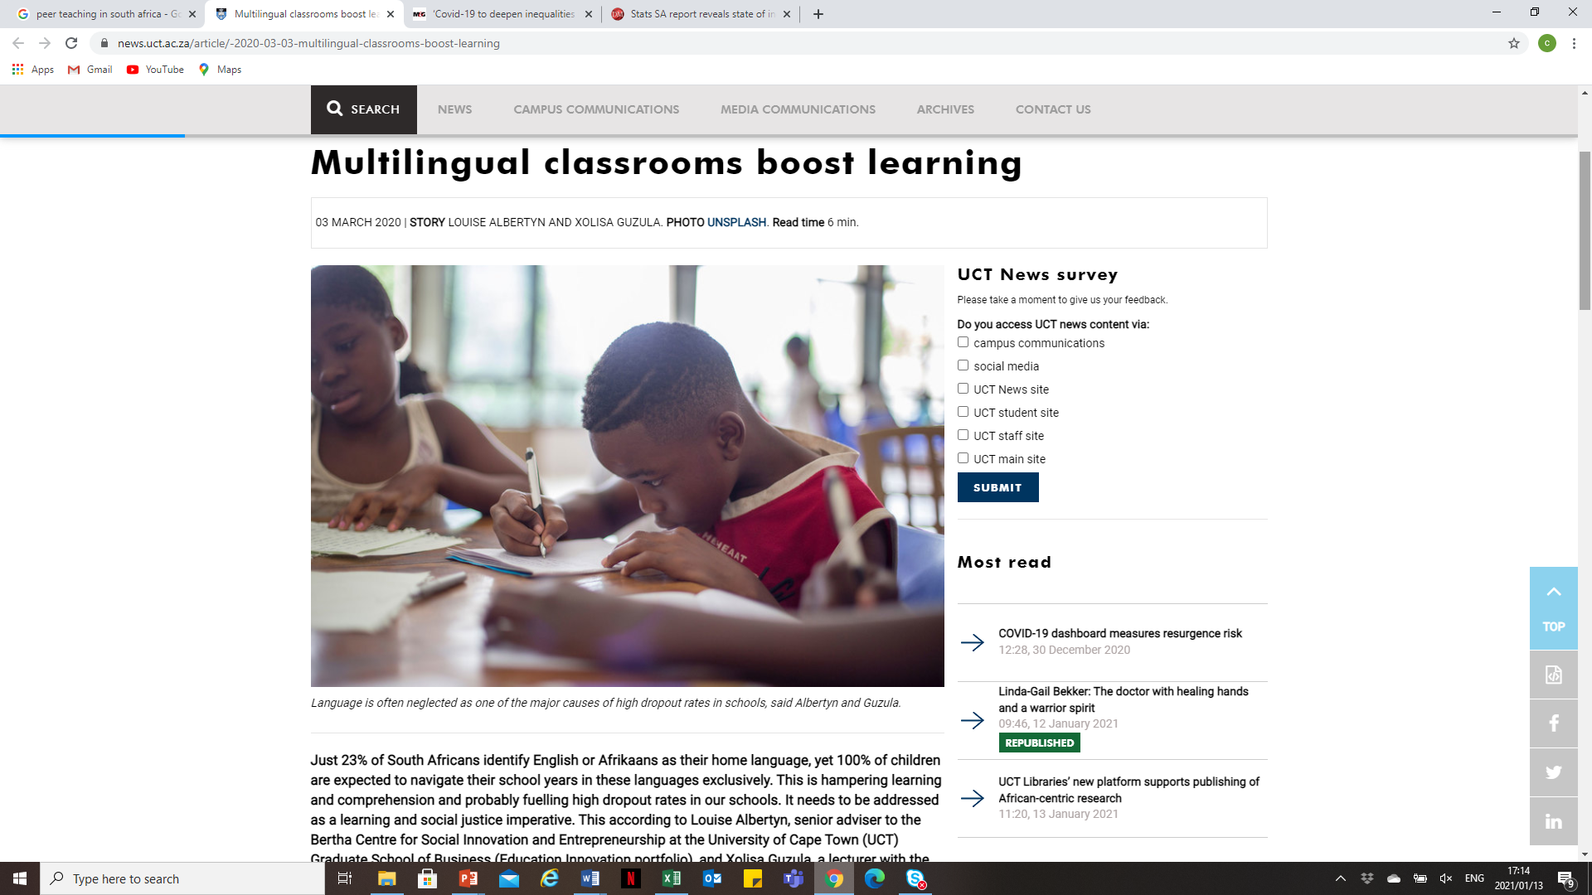
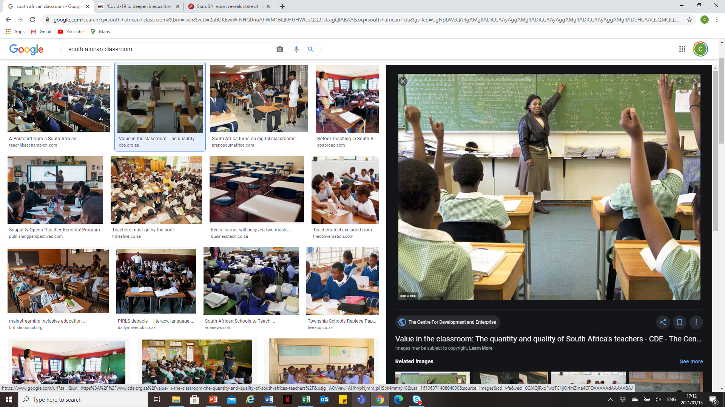



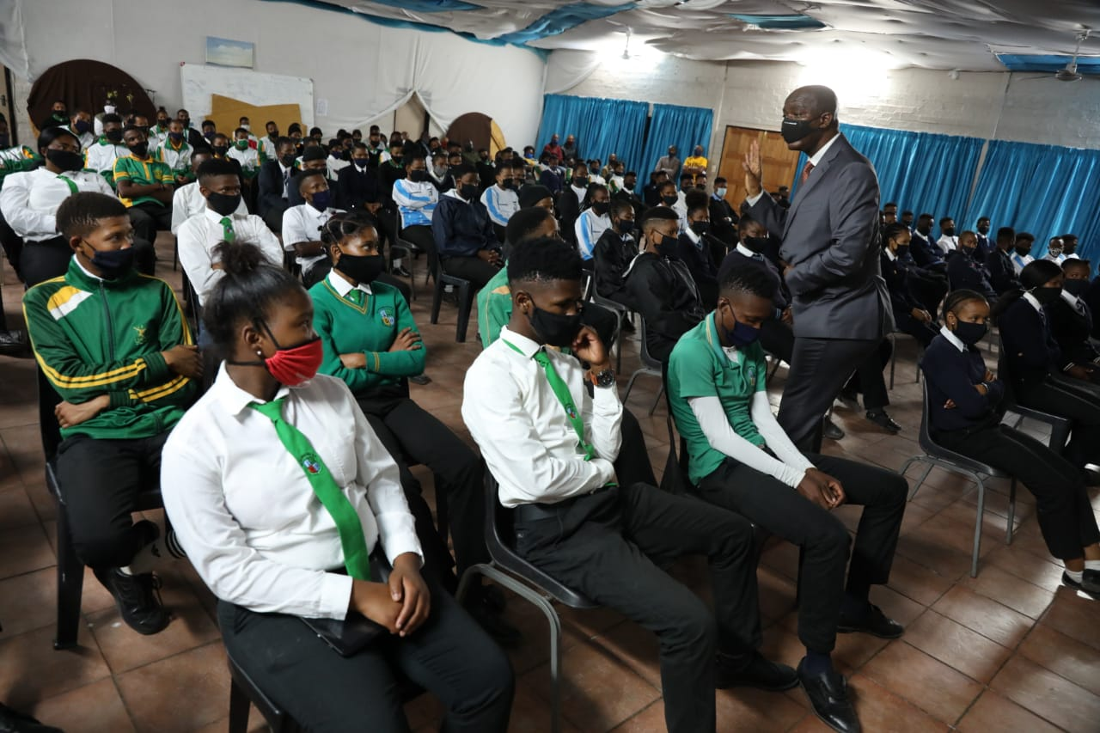
2020 Learner Support Strategies
Notes:
Common Learner support strategies includes, but is not limited to: direct extra tuition in school, vacation classes, the provision of additional study material and ICT resources, and in the last few years we have seen an increase in peer led study groups where learners support each other.

Slide 41
Overview of DBE Support
Director- General’s Oversight Monitoring, Accountability and Support engagements
Direct Curriculum Support Activities
Direct Teacher Development Activities
ICT Provision and Interventions
Additional LTSM provision
Monitoring of Extra Weekend and Vacation Classes

Slide 42
PED Support and Interventions
Teacher Development on content, methodology and assessment in all high enrolment subjects, technical and practical subjects and Home Languages
ICT Interventions including the provision of devices, data, online content, virtual classrooms, broadcast and radio lessons
LTSM provision of additional resources including textbooks, study guides, revision notes and worksheets
Offering of Extra Classes during vacation schools as well as weekends, mornings and afternoons
11

Slide 43
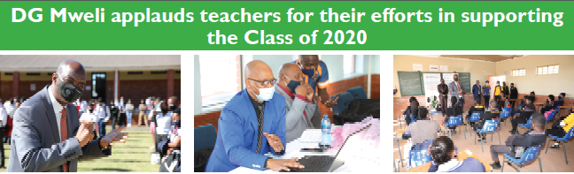
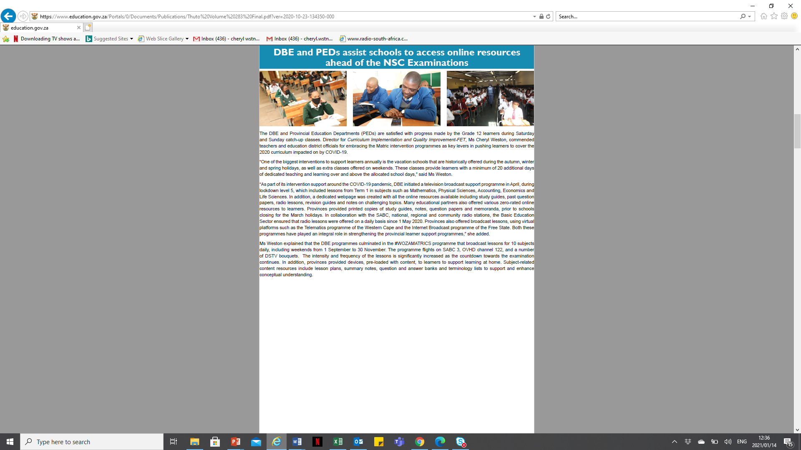
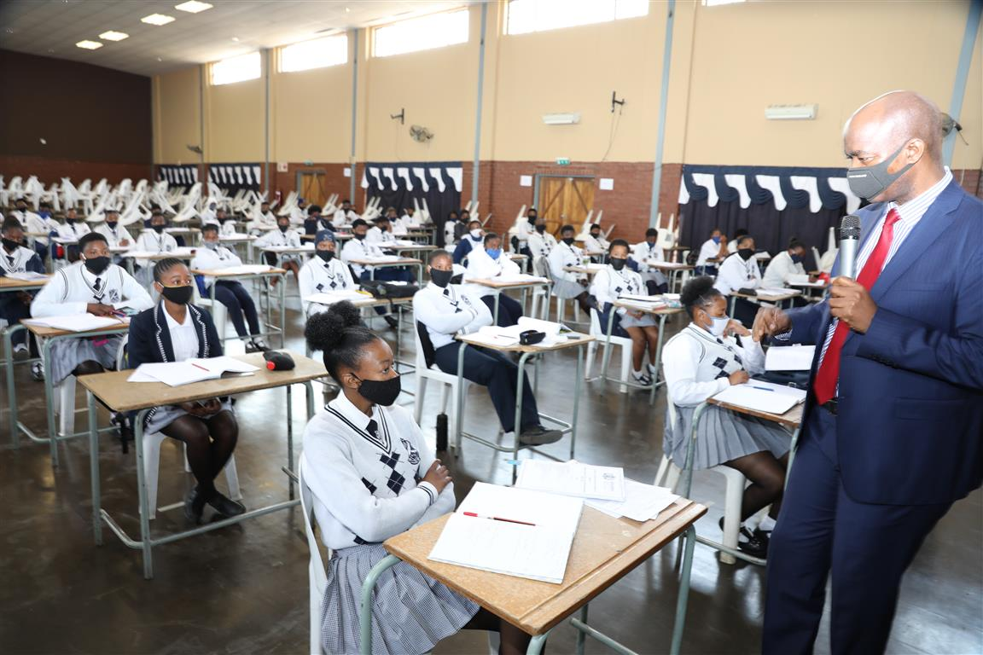
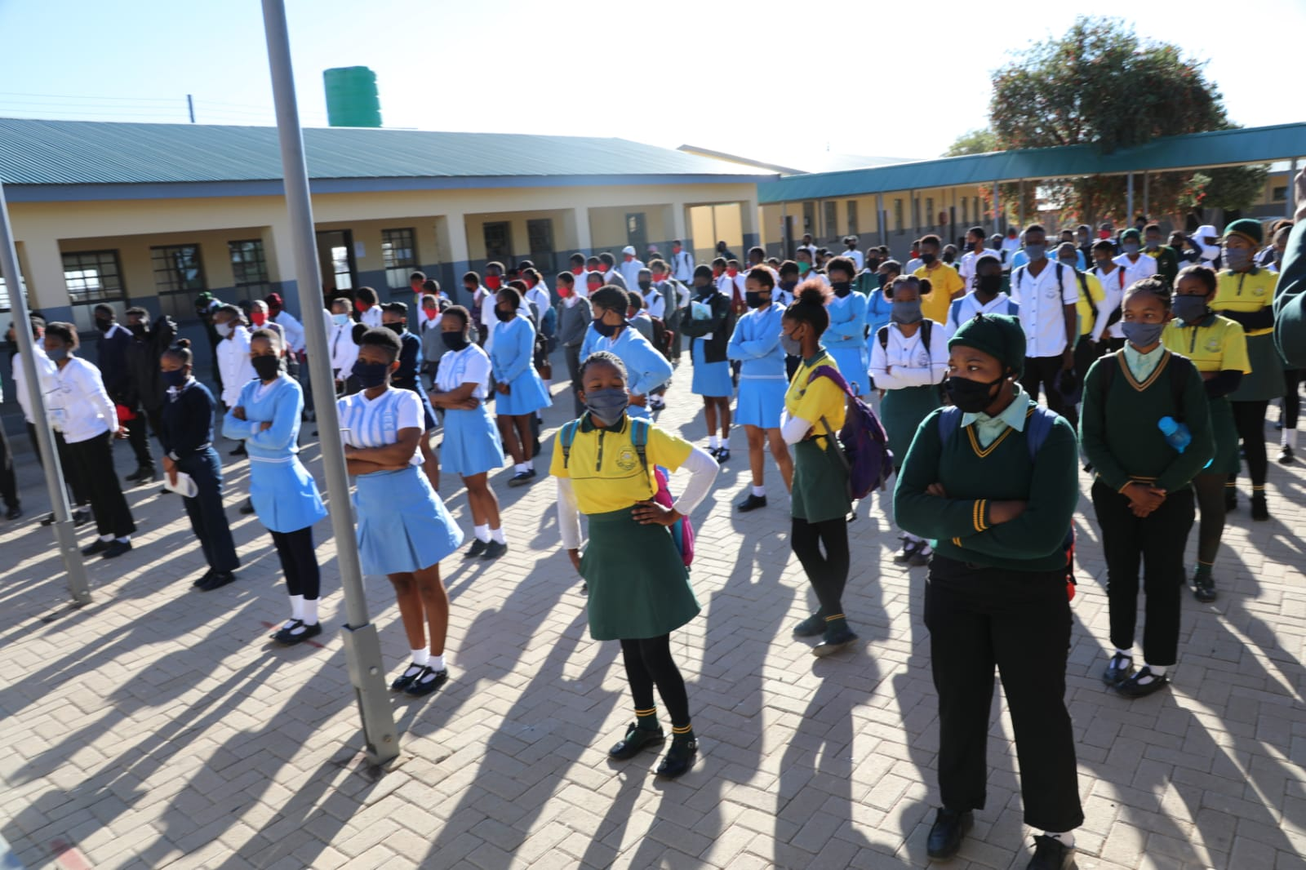
12
Notes:
The Director General focussed on motivating leaners, allaying fears and anxieties of both teachers and learners and affirming the strongest support to the Class of 2020.

Slide 44
SUMMARY
Despite the negative impact of COVID19 on teaching and learning, innovative measures have been developed and used to ensure the readiness of the Class of 2020.
Provinces, Partners, Educational Stakeholders, Parents and Civil Society (NGOs) went beyond the call of duty to assist and support Grade 12 learners;
Whilst significant efforts have been made to recover the academic year and provide extraordinary support to the learners, the total impact of the abnormal educational context remains an unknown and therefore a concern.
Learners, teachers and SMTs are commended for the resilience they have shown in braving the pandemic with a single goal of ensuring the Class of 2020 receives optimum support.

Slide 45
THE 2020 EXAM ARRANGEMENT

Slide 46
COMBINED EXAMINATION
Given that the May/June examination could not be administered, the May/June examination was combined with the October/November examination.
The 2020 Combined June/November examination impacted on writing space and created a need for extra venues and centres for the writing.
The increased numbers was compounded by the need to comply with the Covid-19 social distancing protocol.
This examination accommodated learners with symptoms and those that tested positive

Slide 47
COMBINED NOVEMBER 2020 EXAMINATION
COMBINED JUNE AND NOVEMBER 2020 EXAMINATION
2020 November examination
2020 June Examination
2020 SC Candidates
2019 MEO Candidates
2019 NSC candidates
2020 NSC FT Candidates
2020 NSC PT Candidates

Slide 48
SIZE AND SCOPE
OF
THE 2020 NSC EXAMINATIONS

Slide 49
SCOPE AND SIZE OF THE EXAMINATION
Category | Number
2020 Full Time NSC Candidates | 607 226
2020 Part Time NSC Candidates | 117 808
2020 June SC Candidates | 168 373
2020 June NSC Candidates | 75 358
2020 MEO Candidates | 85 556
TOTAL | 1 054 321

Slide 50
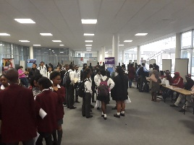
The 2020 NSC Examinations
MARKERS
45 000
MARKING CENTRES
190
EXAMINATION CENTRES
6 872
SCRIPTS
7,6 million
INVIGILATORS
80 000
PRINTED
QUESTION PAPERS
8 million
FULL TIME
607 226
PART TIME
117 808
QUESTION PAPERS
147

Slide 51
NSC Full Time Enrolments: 2016 - 2020

Slide 52
FULL-TIME ENROLMENTS: 2016 TO 2020
Provinces | Entered 2016 | Entered 2017 | Entered 2018 | Entered 2019 | Entered 2020 | Difference 2020 - 2019
Eastern Cape | 92 755 | 82 257 | 81 842 | 79 297 | 77 620 | -1 677
Free State | 28 901 | 27 723 | 29 209 | 30 041 | 29 289 | -752
Gauteng | 112 164 | 108 522 | 107 166 | 111 188 | 115 069 | 3 881
KwaZulu-Natal | 169 023 | 153 125 | 151 166 | 147 554 | 144 307 | -3 247
Limpopo | 110 639 | 100 041 | 96 840 | 93 932 | 79 813 | -14 119
Mpumalanga | 60 794 | 59 500 | 57 867 | 56 833 | 56 030 | -803
North West | 35 403 | 35 733 | 34 718 | 33 057 | 38 292 | 5 235
Northern Cape | 11 821 | 10 519 | 12 157 | 11 459 | 12 021 | 562
Western Cape | 53 152 | 51 735 | 53 768 | 53 393 | 54 785 | 1 392
NATIONAL | 674 652 | 629 155 | 624 733 | 616 754 | 607 226 | -9 528

Slide 53
NSC FULL TIME COHORT 2019-2020
 | 2019 |  | 2020 |  | 2019 | 2020
Provinces | Entered | Wrote | Entered | Wrote | Difference Entered | Difference Wrote
Eastern Cape | 79 297 | 63 198 | 77 620 | 72 926 | -1 677 | 9 728
Free State | 30 041 | 25 572 | 29 289 | 27 928 | -752 | 2 356
Gauteng | 111 188 | 97 829 | 115 069 | 110 191 | 3 881 | 12 362
KwaZulu-Natal | 147 554 | 116 937 | 144 307 | 135 225 | -3 247 | 18 288
Limpopo | 93 932 | 70 847 | 79 813 | 78 695 | -14 119 | 7 848
Mpumalanga | 56 833 | 43 559 | 56 030 | 53 391 | -803 | 9 832
North West | 33 057 | 26 819 | 38 292 | 36 871 | 5 235 | 10 052
Northern Cape | 11 459 | 9 138 | 12 021 | 11 608 | 562 | 2 470
Western Cape | 53 393 | 50 404 | 54 785 | 51 633 | 1 392 | 1 229
NATIONAL | 616 754 | 504 303 | 607 226 | 578 468 | -9 528 | 74 165

Slide 54
NSC Part-Time Enrolment 2014 – 2020

Slide 55
CANDIDATES ENROLLED/WROTE (PART TIME): 2017 - 2020
 | 2017 |  | 2018 |  | 2019 |  | 2020
Province Name | Total Entered | Total Wrote | Total Entered | Total Wrote | Total Entered | Total Wrote | Total Entered | Total Wrote
Eastern Cape | 22 754 | 14 335 | 22 263 | 13 314 | 21 166 | 11 839 | 14 854 | 6 535
Free State | 4 653 | 3 150 | 5 792 | 3 558 | 6 404 | 3 772 | 7 215 | 3 507
Gauteng | 42 066 | 32 060 | 44 057 | 33 191 | 42 787 | 30 248 | 34 316 | 23 371
KwaZulu-Natal | 44 198 | 27 677 | 40 992 | 25 343 | 37 016 | 20 564 | 22 060 | 12 460
Limpopo | 27 853 | 20 251 | 29 483 | 21 118 | 31 998 | 20 114 | 16 119 | 11 023
Mpumalanga | 9 462 | 6 363 | 13 177 | 8 451 | 14 068 | 8 606 | 7 141 | 3 778
North West | 4 597 | 3 655 | 5 651 | 4 232 | 6 281 | 4 370 | 3 429 | 2 443
Northern Cape | 3 678 | 1 912 | 2 203 | 1 448 | 2 079 | 1 288 | 1 709 | 875
Western Cape | 14 015 | 7 820 | 12 492 | 7 006 | 9 164 | 5 584 | 10 965 | 5 322
National | 173 276 | 117 223 | 176 110 | 117 661 | 170 963 | 106 385 | 117 808 | 69 314

Slide 56
Enrolment in terms of Gender
Provinces | Male | Female | Male % | Female %
Eastern Cape | 34 082 | 43 538 | 43.9 | 56.1
Free State | 13 142 | 16 147 | 44.9 | 55.1
Gauteng | 50 810 | 64 259 | 44.2 | 55.8
Kwazulu-Natal | 62 964 | 81 343 | 43.6 | 56.4
Limpopo | 35 657 | 44 156 | 44.7 | 55.3
Mpumalanga | 24 699 | 31 331 | 44.1 | 55.9
North West | 17 191 | 21 101 | 44.9 | 55.1
Northern Cape | 5 308 | 6 713 | 44.2 | 55.8
Western Cape | 23 745 | 31 040 | 43.3 | 56.7
National | 267 598 | 339 628 | 44.1 | 55.9

Slide 57
NSC Subject Enrolment 2016 – 2020
Subjects | Entered 2016 | Entered 2017 | Entered 2018 | Entered 2019 | Entered 2020 | Difference 2020 - 2019
Accounting | 137 808 | 116 949 | 104 553 | 91 581 | 95 864 | 4 283
Agricultural Sciences | 113 119 | 109 713 | 108 794 | 107 068 | 99 942 | -7 126
Business Studies | 248 730 | 226 506 | 216 217 | 211 134 | 215 002 | 3 868
Economics | 165 782 | 145 876 | 133 198 | 125 536 | 123 471 | -2 065
English FAL | 564 814 | 525 061 | 515 937 | 506 050 | 493 829 | -12 221
Geography | 321 829 | 308 347 | 308 014 | 310 705 | 298 020 | -12 685
History | 165 294 | 160 133 | 167 289 | 178 963 | 181 220 | 2 257
Life Sciences | 368 191 | 354 936 | 351 377 | 345 209 | 330 293 | -14 916
Mathematical Literacy | 389 163 | 355 004 | 342 976 | 349 338 | 354 966 | 5 628
Mathematics | 285 406 | 278 224 | 270 516 | 256 338 | 241 013 | -15 325
Physical Sciences | 204 695 | 199 276 | 193 869 | 186 366 | 179 415 | -6 951

Slide 58
ABSENTEEISM IN GATEWAY SUBJECTS
 | 2019 |  |  |  | 2020
Subject Description | Absent | Total Wrote | Total Enrolled | % Absent | Absent | Total Wrote | Total Enrolled | % Absent
Accounting | 11 719 | 76 692 | 91 547 | 12.8% | 3 769 | 92 066 | 95 864 | 3.9%
Agricultural Sciences | 14 577 | 81 392 | 107 029 | 13.6% | 4 567 | 95 148 | 99 942 | 4.6%
Business Studies | 25 167 | 173 651 | 211 095 | 11.9% | 9 890 | 204 173 | 215 001 | 4.6%
Economics | 18 131 | 99 579 | 125 497 | 14.4% | 6 087 | 117 076 | 123 471 | 4.9%
Geography | 39 913 | 248 018 | 310 671 | 12.8% | 12 768 | 284 217 | 298 020 | 4.3%
History | 15 282 | 143 079 | 178 963 | 8.5% | 9 470 | 170 816 | 181 219 | 5.2%
Life Orientation | 7 291 | 504 315 | 616 752 | 1.2% | 19 354 | 578 468 | 607 198 | 3.2%
Life Sciences | 45 061 | 283 338 | 345 175 | 13.1% | 13 379 | 315 945 | 330 293 | 4.1%
Mathematical Literacy | 52 150 | 276 717 | 349 338 | 14.9% | 16 115 | 336 328 | 354 966 | 4.5%
Mathematics | 34 972 | 218 100 | 256 265 | 13.6% | 8 818 | 231 539 | 241 013 | 3.7%
Physical Sciences | 22 185 | 159 626 | 186 332 | 11.9% | 6 177 | 172 626 | 179 415 | 3.4%

Slide 59
NSC 2019 / 2020 Progressed Learners
Province | 2019 |  |  | 2020 |  |  | Difference
 | No Progressed | Total Entered | % Progressed | No Progressed | Total Entered | % Progressed
Eastern Cape | 17 007 | 79 297 | 21.4 | 9 759 | 77 620 | 12.6 | -7 248
Free State | 6 765 | 30 041 | 22.5 | 5 258 | 29 289 | 18.0 | -1 507
Gauteng | 17 038 | 111 188 | 15.3 | 11 655 | 115 069 | 10.1 | -5 383
KwaZulu-Natal | 33 069 | 147 554 | 22.4 | 15 447 | 144 307 | 10.7 | -17 622
Limpopo | 20 961 | 93 932 | 22.3 | 12 050 | 79 813 | 15.1 | -8 911
Mpumalanga | 15 853 | 56 833 | 27.9 | 6 564 | 56 030 | 11.7 | -9 289
North West | 8 549 | 33 057 | 25.9 | 4 189 | 38 292 | 10.9 | -4 360
Northern Cape | 2 778 | 11 459 | 24.2 | 2 427 | 12 021 | 20.2 | -351
Western Cape | 3 671 | 53 393 | 6.9 | 3 216 | 54 785 | 5.9 | -455
National | 125 691 | 616 754 | 20.4 | 70 565 | 607 226 | 11.6 | -55 126

Slide 60
SPECIAL NEEDS EDUCATION
Province Name | Entered | Wrote
Eastern Cape | 32 | 32
Free State | 1 151 | 1 122
Gauteng | 758 | 687
Kwazulu-Natal | 55 | 53
Limpopo | 31 | 31
Mpumalanga | 42 | 42
North West | 27 | 27
Northern Cape | 21 | 21
Western Cape | 44 | 43
NATIONAL | 2 161 | 2 058

Slide 61
Correctional Services – Full Time
38
Province Name | Total Entered | Total Wrote | Total Entered | Total Wrote
 | FULL -TIME |  | PART-TIME
Western Cape | 16 | 16 | 0 | 0
Eastern Cape | 35 | 34 | 0 | 0
Kwazulu-Natal | 35 | 34 | 7 | 1
Mpumalanga | 25 | 23 | 0 | 0
Gauteng | 12 | 11 | 19 | 19
North West | 10 | 6 | 2 | 2
Limpopo | 0 | 0 | 17 | 16
Northern Cape | 0 | 0 | 10 | 10
Total | 133 | 124 | 55 | 48

Slide 62
SOCIAL GRANT ENROLMENTS
ProvinceName | Active | Inactive | Provincial
EASTERN CAPE | 13 341 | 50 292 | 63 633
FREE STATE | 4 640 | 17 503 | 22 143
GAUTENG | 18 865 | 53 193 | 72 058
KWAZULU-NATAL | 28 733 | 88 797 | 117 530
LIMPOPO | 14 148 | 54 191 | 68 339
MPUMALANGA | 9 823 | 36 567 | 46 390
NORTH WEST | 6 312 | 24 348 | 30 660
NORTHERN CAPE | 1 885 | 7 578 | 9 463
WESTERN CAPE | 7 774 | 24 252 | 32 026
NATIONAL | 105 521 | 356 721 | 462 242

Slide 63
STANDARDISATION

Slide 64
STANDARDISATION OF NSC RESULTS: 2008-2020
Year | Subjects | Raw marks Accepted | Adjusted downwards | Adjusted upwards
2008 | 55 | 30 (55%) | 4 | 21
2009 | 58 | 43 (74%) | 5 | 10
2010 | 58 | 39 (67%) | 10 | 9
2011 | 56 | 45 (80%) | 8 | 3
2012 | 60 | 49 (82%) | 6 | 6
2013 | 59 | 38 (64%) | 16 | 5
2014 | 58 | 35 (60%) | 7 | 16
2015 | 59 | 29 (49%) | 0 | 30
2016 | 58 | 26 (45%) | 4 | 28
2017 | 58 | 38 (66%) | 4 | 16
2018 | 67 | 39 (58%) | 11 | 17
2019 | 67 | 47 (70%) | 7 | 13
2020 | 65 | 48(74%) | 8 | 9

Slide 65
HISTORICAL TRENDS

Slide 66
THE NUMBER OF CANDIDATES PASSING MATRIC SINCE 1970

Slide 67
NSC PERFORMANCE 2014 - 2020

Slide 68
OVERALL NATIONAL RESULTS 2020

Slide 69
PERFORMANCE OF THE CLASS OF 2020
Province | 2019 |  |  |  | 2020 |  |  |  | % Difference
 | Total Wrote | Total Achieved | % Achieved | Ranking | Total Wrote | Total Achieved | % Achieved | Ranking
EASTERN CAPE | 63 198 | 48 331 | 76.5 | 7 | 72 926 | 49 691 | 68.1 | 8 | -8.3
FREE STATE | 25 572 | 22 602 | 88.4 | 1 | 27 928 | 23 779 | 85.1 | 1 | -3.2
GAUTENG | 97 829 | 85 342 | 87.2 | 2 | 110 191 | 92 285 | 83.8 | 2 | -3.5
KWAZULU-NATAL | 116 937 | 95 017 | 81.3 | 5 | 135 225 | 104 938 | 77.6 | 4 | -3.7
LIMPOPO | 70 847 | 51 855 | 73.2 | 9 | 78 695 | 53 634 | 68.2 | 7 | -5.0
MPUMALANGA | 43 559 | 34 995 | 80.3 | 6 | 53 391 | 39 367 | 73.7 | 6 | -6.6
NORTH WEST | 26 819 | 23 272 | 86.8 | 3 | 36 871 | 28 093 | 76.2 | 5 | -10.6
NORTHERN CAPE | 9 138 | 6 990 | 76.5 | 7 | 11 608 | 7 665 | 66.0 | 9 | -10.5
WESTERN CAPE | 50 404 | 41 502 | 82.3 | 4 | 51 633 | 41 250 | 79.9 | 3 | -2.4
NATIONAL | 504 303 | 409 906 | 81.3 |  | 578 468 | 440 702 | 76.2 |  | -5.1

Slide 70
PERFORMANCE OF THE CLASS OF 2020 BY FEE PAYING STATUS
 | 2020
 | Fee Paying |  |  |  | Non Fee Paying |  |  |  | Independent
Province | Total Wrote | Total Achieved | % Achieved | RANK | Total Wrote | Total Achieved | % Achieved | RANK | Total Wrote | Total Achieved | % Achieved | RANK | Overall Ranking
Free State | 6 685 | 6 017 | 90.00% | 5 | 20 625 | 17 171 | 83.30% | 8 | 618 | 591 | 95.60% | 9 | 1
Gauteng | 61 008 | 52 680 | 86.30% | 1 | 40 588 | 31 709 | 78.10% | 1 | 8 595 | 7 896 | 91.90% | 1 | 2
Western Cape | 33 025 | 27 881 | 84.40% | 6 | 17 247 | 12 157 | 70.50% | 2 | 1 361 | 1 212 | 89.10% | 3 | 3
KwaZulu-Natal | 37 521 | 30 959 | 82.50% | 8 | 94 490 | 71 296 | 75.50% | 3 | 3 214 | 2 683 | 83.50% | 7 | 4
North-West | 7 642 | 6 699 | 87.70% | 3 | 28 530 | 20 747 | 72.70% | 7 | 699 | 647 | 92.60% | 4 | 5
Mpumalanga | 5 832 | 5 164 | 88.50% | 2 | 45 410 | 32 405 | 71.40% | 5 | 2 149 | 1 798 | 83.70% | 6 | 6
Limpopo | 4 837 | 4 280 | 88.50% | 4 | 71 015 | 46 808 | 65.90% | 4 | 2 843 | 2 546 | 89.60% | 2 | 7
Eastern Cape | 9 217 | 8 000 | 86.80% | 9 | 60 924 | 39 485 | 64.80% | 9 | 2 785 | 2 206 | 79.20% | 8 | 8
Northern Cape | 4 506 | 3 584 | 79.50% | 7 | 6 888 | 3 904 | 56.70% | 6 | 214 | 177 | 82.70% | 5 | 9
National | 170 273 | 145 264 | 85.30% | 1 | 385 717 | 275 682 | 71.50% | 1 | 22 478 | 19 756 | 87.90% | 1

Slide 71
NSC PASSES
BY
QUALIFICATION TYPE

Slide 72
NSC PASSES BY TYPE OF QUALIFICATION, 2020
Province | Total Wrote | Bachelor |  | Diploma |  | Higher Certificate |  | NSC
 |  | Achieved | % Achieved | Achieved | % Achieved | Achieved | % Achieved | Achieved | % Achieved
Eastern Cape | 72 926 | 21 886 | 30.0 | 17 753 | 24.3 | 10 039 | 13.8 | 13 | 0.0
Free State | 27 928 | 11 284 | 40.4 | 8 740 | 31.3 | 3 740 | 13.4 | 0 | 0.0
Gauteng | 110 191 | 49 680 | 45.1 | 30 675 | 27.8 | 11 879 | 10.8 | 1 | 0.0
KwaZulu-Natal | 135 225 | 51 060 | 37.8 | 35 195 | 26.0 | 18 658 | 13.8 | 24 | 0.0
Limpopo | 78 695 | 22 907 | 29.1 | 18 588 | 23.6 | 12 134 | 15.4 | 5 | 0.0
Mpumalanga | 53 391 | 16 251 | 30.4 | 14 421 | 27.0 | 8 677 | 16.3 | 18 | 0.0
North West | 36 871 | 11 822 | 32.1 | 9 987 | 27.1 | 6 282 | 17.0 | 0 | 0.0
Northern Cape | 11 608 | 3 296 | 28.4 | 2 797 | 24.1 | 1 567 | 13.5 | 0 | 0.0
Western Cape | 51 633 | 22 634 | 43.8 | 12 444 | 24.1 | 6 141 | 11.9 | 0 | 0.0
National | 578 468 | 210 820 | 36.4 | 150 600 | 26.0 | 79 117 | 13.7 | 61 | 0.0

Slide 73
NSC PASSES BY QUALIFICATION & FEE STATUS 2020
 | Fee Status
 | Fee Paying |  |  |  |  | No Fee |  |  |  |  | Independent
Province | Total Wrote | Achieved Bachelor | % Achieved Bachelor | Achieved Diploma | % Achieved Diploma | Total Wrote | Achieved Bachelor | % Achieved Bachelor | Achieved Diploma | % Achieved Diploma | Total Wrote | Achieved Bachelor | % Achieved Bachelor | Achieved Diploma | % Achieved Diploma
Eastern Cape | 9 217 | 4 939 | 53.6% | 2 310 | 25.1% | 60 924 | 15 881 | 26.1% | 14 655 | 24.1% | 2 785 | 1 066 | 38.3% | 788 | 28.3%
Free State | 6 685 | 3 591 | 53.7% | 1 834 | 27.4% | 20 625 | 7 365 | 35.7% | 6 693 | 32.5% | 618 | 328 | 53.1% | 213 | 34.5%
Gauteng | 61 008 | 29 323 | 48.1% | 17 025 | 27.9% | 40 588 | 15 222 | 37.5% | 11 456 | 28.2% | 8 595 | 5 135 | 59.7% | 2 194 | 25.5%
KwaZulu-Natal | 37 521 | 17 107 | 45.6% | 9 515 | 25.4% | 94 490 | 32 207 | 34.1% | 25 014 | 26.5% | 3 214 | 1 746 | 54.3% | 666 | 20.7%
Limpopo | 4 837 | 2 780 | 57.5% | 1 087 | 22.5% | 71 015 | 18 551 | 26.1% | 16 821 | 23.7% | 2 843 | 1 576 | 55.4% | 680 | 23.9%
Mpumalanga | 5 832 | 3 004 | 51.5% | 1 626 | 27.9% | 45 410 | 12 417 | 27.3% | 12 119 | 26.7% | 2 149 | 830 | 38.6% | 676 | 31.5%
North-West | 7 642 | 3 712 | 48.6% | 2 085 | 27.3% | 28 530 | 7 745 | 27.1% | 7 700 | 27.0% | 699 | 365 | 52.2% | 202 | 28.9%
Northern Cape | 4 506 | 1 847 | 41.0% | 1 244 | 27.6% | 6 888 | 1 376 | 20.0% | 1 498 | 21.7% | 214 | 73 | 34.1% | 55 | 25.7%
Western Cape | 33 025 | 17 160 | 52.0% | 7 463 | 22.6% | 17 247 | 4 680 | 27.1% | 4 675 | 27.1% | 1 361 | 794 | 58.3% | 306 | 22.5%
National | 170 273 | 83 463 | 49.0% | 44 189 | 26.0% | 385 717 | 115 444 | 29.9% | 100 631 | 26.1% | 22 478 | 11 913 | 53.0% | 5 780 | 25.7%

Slide 74
NSC PASSES BY QUALIFICATION & FEE STATUS 2020-RANKED
Province | Fee Status
 | Fee Paying |  |  |  | No Fee |  |  |  | Independent
 | % Achieved Bachelor | RANK Bachelors along Table (Down) | % Achieved Diploma | RANK Diploma along Table (Down) | % Achieved Bachelor | RANK Bachelors along Table (Down) | % Achieved Diploma | RANK Diploma along Table (Down) | % Achieved Bachelor | RANK Bachelors along Table (Down) | % Achieved Diploma | RANK Diploma along Table (Down)
Eastern Cape | 53.6% | 3 | 25.1% | 7 | 26.1% | 8 | 24.1% | 7 | 38.3% | 8 | 28.3% | 4
Free State | 53.7% | 2 | 27.4% | 4 | 35.7% | 2 | 32.5% | 1 | 53.1% | 5 | 34.5% | 1
Gauteng | 48.1% | 7 | 27.9% | 1 | 37.5% | 1 | 28.2% | 2 | 59.7% | 1 | 25.5% | 6
KwaZulu-Natal | 45.6% | 8 | 25.4% | 6 | 34.1% | 3 | 26.5% | 6 | 54.3% | 4 | 20.7% | 9
Limpopo | 57.5% | 1 | 22.5% | 9 | 26.1% | 7 | 23.7% | 8 | 55.4% | 3 | 23.9% | 7
Mpumalanga | 51.5% | 5 | 27.9% | 2 | 27.3% | 4 | 26.7% | 5 | 38.6% | 7 | 31.5% | 2
North-West | 48.6% | 6 | 27.3% | 5 | 27.1% | 5 | 27.0% | 4 | 52.2% | 6 | 28.9% | 3
Northern Cape | 41.0% | 9 | 27.6% | 3 | 20.0% | 9 | 21.7% | 9 | 34.1% | 9 | 25.7% | 5
Western Cape | 52.0% | 4 | 22.6% | 8 | 27.1% | 6 | 27.1% | 3 | 58.3% | 2 | 22.5% | 8
National | 49.0% |  | 26.0% |  | 29.9% |  | 26.1% |  | 53.0% |  | 25.7%

Slide 75
BACHELOR PASS TREND (PERCENTAGE): 2013 - 2020

Slide 76
BACHELOR PASS TREND (NUMBERS): 2013 - 2020

Slide 77
BACHELOR PASS (NUMBERS) PER PROVINCE 2020

Slide 78
BACHELOR PASS (PERCENTAGES) PER PROVINCE 2020

Slide 79
BACHELOR ACHIEVEMENTS: 2019 AND 2020
Province | 2019 |  |  | 2020
 | Number Wrote | Number Achieved with Bachelor | % Achieved with Bachelor | Number Wrote | Number Achieved with Bachelor | % Achieved with Bachelor
Eastern Cape | 63 198 | 20 419 | 32.3 | 72 926 | 21 886 | 30.0
Free State | 25 572 | 9 992 | 39.1 | 27 928 | 11 284 | 40.4
Gauteng | 97 829 | 43 494 | 44.5 | 110 191 | 49 680 | 45.1
Kwazulu-Natal | 116 937 | 44 189 | 37.8 | 135 225 | 51 060 | 37.8
Limpopo | 70 847 | 19 022 | 26.8 | 78 695 | 22 907 | 29.1
Mpumalanga | 43 559 | 14 228 | 32.7 | 53 391 | 16 251 | 30.4
North West | 26 819 | 9 964 | 37.2 | 36 871 | 11 822 | 32.1
Northern Cape | 9 138 | 2 769 | 30.3 | 11 608 | 3 296 | 28.4
Western Cape | 50 404 | 21 981 | 43.6 | 51 633 | 22 634 | 43.8
National | 504 303 | 186 058 | 36.9 | 578 468 | 210 820 | 36.4

Slide 80
TYPE OF PASSES PER QUINTILE
 | 2019 |  | 2020
Quintiles | Q 1-3 | Q 4-5 | Q 1-3 | Q 4-5
No of Bachelors | 96 976 | 78 037 | 115478 | 83463
% Bachelors | 19.2% | 15.5% | 20.0% | 14.4%

Slide 81
PROGRESSED LEARNERS

Slide 82
PERFORMANCE OF THE CLASS OF 2020
(PROGRESSED LEARNERS EXCLUDED)
Province | 2019 |  |  | 2020 |  |  | % Difference
 | Total Wrote | Total Achieved | % Achieved | Total Wrote | Total Achieved | % Achieved
EASTERN CAPE | 59 045 | 45 618 | 77.3 | 63 901 | 47 431 | 74.2 | -3.1
FREE STATE | 22 342 | 20 353 | 91.1 | 23 038 | 21 097 | 91.6 | 0.5
GAUTENG | 91 256 | 80 802 | 88.5 | 99 493 | 87 903 | 88.4 | -0.1
KWAZULU-NATAL | 110 475 | 90 377 | 81.8 | 121 374 | 99 437 | 81.9 | 0.1
LIMPOPO | 66 374 | 48 866 | 73.6 | 66 912 | 49 439 | 73.9 | 0.3
MPUMALANGA | 39 126 | 31 783 | 81.2 | 47 129 | 36 690 | 77.9 | -3.3
NORTH WEST | 24 134 | 21 191 | 87.8 | 32 876 | 26 787 | 81.5 | -6.3
NORTHERN CAPE | 8 570 | 6 649 | 77.6 | 9 343 | 7 111 | 76.1 | -1.5
WESTERN CAPE | 48 494 | 40 785 | 84.1 | 48 903 | 40 563 | 82.9 | -1.2
NATIONAL | 469 816 | 386 424 | 82.3 | 512 969 | 416 458 | 81.2 | -1.1

Slide 83
PROGRESSED LEARNERS EXCLUDED

Slide 84
PERFORMANCE OF PROGRESSED CANDIDATES ONLY 2019
Provinces | Progressed Candidates 2019
 | Entered | Wrote (all 7 subjects) | Achieved | % Achieved
Eastern Cape | 17 007 | 4 152 | 2 712 | 65.3
Free State | 6 765 | 3 230 | 2 249 | 69.6
Gauteng | 17 038 | 6 573 | 4 540 | 69.1
Kwazulu-Natal | 33 069 | 6 462 | 4 640 | 71.8
Limpopo | 20 961 | 4 473 | 2 989 | 66.8
Mpumalanga | 15 853 | 4 445 | 3 216 | 72.4
North West | 8 549 | 2 685 | 2 081 | 77.5
Northern Cape | 2 778 | 568 | 341 | 60.0
Western Cape | 3 671 | 1 910 | 717 | 37.5
National | 125 691 | 34 498 | 23 485 | 68.1

Slide 85
PERFORMANCE OF PROGRESSED CANDIDATES ONLY 2020
Provinces | Progressed Candidates 2020
 | Entered | Wrote (all 7 subjects) | Achieved | % Achieved
Eastern Cape | 9 759 | 9 025 | 2 260 | 25.0
Free State | 5 258 | 4 890 | 2 682 | 54.8
Gauteng | 11 655 | 10 698 | 4 382 | 41.0
Kwazulu-Natal | 15 447 | 13 851 | 5 501 | 39.7
Limpopo | 12 050 | 11 783 | 4 195 | 35.6
Mpumalanga | 6 564 | 6 262 | 2 677 | 42.7
North West | 4 189 | 3 995 | 1 306 | 32.7
Northern Cape | 2 427 | 2 265 | 554 | 24.5
Western Cape | 3 216 | 2 730 | 687 | 25.2
National | 70 565 | 65 499 | 24 244 | 37.0

Slide 86
ACHIEVEMENT TYPES OF PROGRESSED LEARNERS
Province Name | Total Wrote | Achieved Bachelor | % Achieved Bachelor | Achieved Diploma | % Achieved Diploma | Achieved H-Cert | % Achieved H-Cert | Achieved NSC | Achieved Endorsed NSC | Total Achieved | % Achieved
EASTERN CAPE | 9 025 | 213 | 2.4 | 868 | 9.6 | 1 178 | 13.1 | 1 | 0 | 2 260 | 25.0
FREE STATE | 4 890 | 282 | 5.8 | 1 189 | 24.3 | 1 206 | 24.7 | 0 | 5 | 2 677 | 54.7
GAUTENG | 10 698 | 588 | 5.5 | 2 068 | 19.3 | 1 722 | 16.1 | 0 | 4 | 4 378 | 40.9
KWAZULU-NATAL | 13 851 | 827 | 6.0 | 2 331 | 16.8 | 2 341 | 16.9 | 2 | 0 | 5 501 | 39.7
LIMPOPO | 11 783 | 551 | 4.7 | 1 660 | 14.1 | 1 981 | 16.8 | 3 | 0 | 4 195 | 35.6
MPUMALANGA | 6 262 | 345 | 5.5 | 1 057 | 16.9 | 1 270 | 20.3 | 5 | 0 | 2 677 | 42.7
NORTH WEST | 3 995 | 113 | 2.8 | 446 | 11.2 | 746 | 18.7 | 0 | 1 | 1 305 | 32.7
NORTHERN CAPE | 2 265 | 52 | 2.3 | 221 | 9.8 | 281 | 12.4 | 0 | 0 | 554 | 24.5
WESTERN CAPE | 2 730 | 55 | 2.0 | 267 | 9.8 | 363 | 13.3 | 0 | 2 | 685 | 25.1
NATIONAL | 65 499 | 3 026 | 4.6 | 10 107 | 15.4 | 11 088 | 16.9 | 11 | 12 | 24 232 | 37.0

Slide 87
% ACHIEVED PROGRESSED ONLY

Slide 88
SCHOOL PERFORMANCE
BY QUINTILES

Slide 89
SCHOOL PERFORMANCE BY QUINTILE - 2019
Quintiles | 0 - 19.9% | 20 - 39.9% | 40 - 59.9% | 60 - 79.9% | 80 - 100% | Exactly 0% | Exactly 100%
Quintile 1 | 29 | 94 | 278 | 565 | 849 | 10 | 126
Quintile 2 | 15 | 75 | 183 | 530 | 884 | 4 | 122
Quintile 3 | 7 | 38 | 180 | 481 | 751 | 2 | 58
Quintile 4 | 1 | 5 | 23 | 180 | 408 | 0 | 36
Quintile 5 | 0 | 1 | 16 | 104 | 603 | 0 | 97
Total | 52 | 213 | 680 | 1 860 | 3 495 | 16 | 439

Slide 90
SCHOOL PERFORMANCE BY QUINTILE - 2020
Quintiles | 0 - 19.9% | 20 - 39.9% | 40 - 59.9% | 60 - 79.9% | 80 - 100% | Exactly 0% | Exactly 100%
Quintile 1 | 26 | 141 | 387 | 611 | 642 | 5 | 82
Quintile 2 | 15 | 101 | 333 | 616 | 600 | 3 | 63
Quintile 3 | 9 | 77 | 278 | 609 | 494 | 1 | 31
Quintile 4 | 0 | 7 | 53 | 225 | 324 | 0 | 36
Quintile 5 | 0 | 4 | 23 | 109 | 601 | 0 | 90
Total | 50 | 330 | 1 074 | 2 170 | 2 661 | 9 | 302

Slide 91
SUBJECT
PERFORMANCE

Slide 92
CANDIDATES’ PERFORMANCE IN SELECTED
SUBJECTS, 2016 – 2020 (AT 30% LEVEL)
Subjects | 2016 | 2017 | 2018 | 2019 | 2020
Accounting | 69.5 | 66.1 | 72.5 | 78.4 | 75.5
Agricultural Sciences | 75.4 | 70.4 | 69.9 | 74.6 | 72.7
Business Studies | 73.7 | 68.0 | 64.9 | 71.0 | 77.9
Economics | 65.3 | 71.0 | 73.3 | 69.3 | 68.8
Geography | 76.5 | 76.9 | 74.2 | 80.5 | 75.3
History | 84.0 | 86.0 | 89.7 | 90.0 | 92.1
Life Orientation | 99.7 | 99.8 | 99.7 | 99.8 | 99.4
Life Sciences | 70.5 | 74.4 | 76.3 | 72.3 | 71.0
Mathematical Literacy | 71.3 | 73.9 | 72.5 | 80.6 | 80.8
Mathematics | 51.1 | 51.9 | 58.0 | 54.6 | 53.8
Physical Sciences | 62.0 | 65.1 | 74.2 | 75.5 | 65.8

Slide 93
CANDIDATES’ PERFORMANCE IN SELECTED
SUBJECTS, 2016 – 2020 (AT 40% LEVEL)
Subjects | 2016 | 2017 | 2018 | 2019 | 2020
Accounting | 44.9 | 42.6 | 48.6 | 52.6 | 52.9
Agricultural Sciences | 44.5 | 39.9 | 41.8 | 45.7 | 45.9
Business Studies | 49.5 | 42.7 | 40.1 | 46.2 | 57.0
Economics | 36.4 | 42.7 | 44.8 | 39.9 | 42.2
English FAL | 82.5 | 83.1 | 82.1 | 85.4 | 91.4
Geography | 48.1 | 50.1 | 46.7 | 53.3 | 46.2
History | 64.3 | 67.5 | 72.6 | 74.0 | 77.6
Life Sciences | 45.2 | 52.1 | 51.7 | 49.0 | 47.9
Mathematical Literacy | 46.4 | 45.0 | 45.4 | 54.5 | 57.7
Mathematics | 33.5 | 35.1 | 37.1 | 35.0 | 35.6
Physical Sciences | 39.5 | 42.2 | 48.7 | 51.7 | 42.4

Slide 94
CANDIDATES’ PERFORMANCE IN
HOME LANGUAGES @ 40% LEVEL
 | 2017 | 2018 | 2019 | 2020
Afrikaans | 94.5 | 96.4 | 95.2 | 95.4
English | 93.1 | 92.7 | 92.0 | 94.5
IsiNdebele | 99.6 | 99.7 | 99.8 | 99.9
IsiXhosa | 99.8 | 99.7 | 99.7 | 99.6
IsiZulu | 98.9 | 98.8 | 99.2 | 99.0
Sepedi | 98.6 | 98.6 | 98.2 | 98.7
Sesotho | 99.4 | 99.4 | 99.3 | 99.1
Setswana | 99.7 | 99.6 | 99.5 | 99.5
SiSwati | 99.2 | 99.3 | 99.0 | 99.6
SA Sign Language | - | 96.2 | 96.9 | 97.0
Tshivenda | 99.8 | 99.9 | 99.9 | 99.9
Xitsonga | 99.0 | 98.9 | 98.7 | 99.2

Slide 95
FIRST ADDITIONAL LANGUAGE @ 30% LEVEL (2017 – 2020)
First Additional Language | 2017 | 2018 | 2019 | 2020
Afrikaans First Additional Language | 93.0 | 93.9 | 96.0 | 93.8
English First Additional Language | 97.0 | 97.2 | 97.6 | 99.2

Slide 96
DISTRICT
PERFORMANCE

Slide 97
DISTRICT PERFORMANCE BY ACHIEVEMENT INTERVAL AND PROVINCE: 2019
Province | Total number of Districts | 2019
 |  | Below 50% | 50% to 59.9% | 60% to 69.9% | 70% to 79.9% | 80% and above
EC | 12 | 0 | 0 | 1 | 10 | 1
FS | 5 | 0 | 0 | 0 | 0 | 5
GP | 15 | 0 | 0 | 0 | 0 | 15
KZN | 12 | 0 | 0 | 0 | 5 | 7
LP | 10 | 0 | 0 | 5 | 2 | 3
MP | 4 | 0 | 0 | 0 | 2 | 2
NW | 4 | 0 | 0 | 0 | 0 | 4
NC | 5 | 0 | 0 | 0 | 4 | 1
WC | 8 | 0 | 0 | 0 | 1 | 7
Total | 75 | 0 | 0 | 6 | 24 | 45

Slide 98
DISTRICT PERFORMANCE BY ACHIEVEMENT
INTERVAL AND PROVINCE: 2020
Province | Total number of Districts | 2020
 |  | Below 50% | 50% to 59.9% | 60% to 69.9% | 70% to 79.9% | 80% & above
EC | 12 | 0 | 0 | 9 | 3 | 0
FS | 5 | 0 | 0 | 0 | 0 | 5
GP | 15 | 0 | 0 | 0 | 4 | 11
KZN | 12 | 0 | 0 | 0 | 7 | 5
LP | 10 | 0 | 2 | 4 | 4 | 0
MP | 4 | 0 | 0 | 0 | 4 | 0
NW | 4 | 0 | 0 | 1 | 2 | 1
NC | 5 | 0 | 0 | 3 | 2 | 0
WC | 8 | 0 | 0 | 0 | 4 | 4
Total | 75 | 0 | 2 | 17 | 30 | 26

Slide 99
TOP TEN DISTRICTS
69
Province Name | District Name | Total Wrote | Total Achieved | % Achieved
GAUTENG | TSHWANE SOUTH | 10 993 | 9 848 | 89.6
GAUTENG | JOHANNESBURG WEST | 5 615 | 4 946 | 88.1
GAUTENG | GAUTENG NORTH | 1 837 | 1 598 | 87.0
GAUTENG | JOHANNESBURG NORTH | 7 445 | 6 473 | 86.9
GAUTENG | SEDIBENG EAST | 2 943 | 2 555 | 86.8
FREE STATE | FEZILE DABI | 4 638 | 4 012 | 86.5
FREE STATE | THABO MOFUTSANYANA | 7 657 | 6 572 | 85.8
GAUTENG | EKURHULENI SOUTH | 11 731 | 10 022 | 85.4
WESTERN CAPE | METRO NORTH | 7 885 | 6 736 | 85.4
FREE STATE | MOTHEO | 8 593 | 7 324 | 85.2

Slide 100
BOTTOM TEN DISTRICTS
Province Name | District Name | Total Wrote | Total Achieved | % Achieved
EASTERN CAPE | OR TAMBO INLAND | 8 933 | 5 823 | 65.2
EASTERN CAPE | OR TAMBO COASTAL | 9 127 | 5 947 | 65.2
NORTHERN CAPE | FRANCES BAARD | 4 010 | 2 605 | 65.0
LIMPOPO | CAPRICORN NORTH | 7 874 | 5 065 | 64.3
EASTERN CAPE | AMATHOLE WEST | 3 065 | 1 936 | 63.2
EASTERN CAPE | CHRIS HANI EAST | 4 118 | 2 562 | 62.2
EASTERN CAPE | JOE GQABI | 3 781 | 2 325 | 61.5
NORTHERN CAPE | JOHN TAOLO GAETSEWE | 3 166 | 1 900 | 60.0
LIMPOPO | SEKHUKHUNE SOUTH | 9 016 | 5 355 | 59.4
LIMPOPO | SEKHUKHUNE EAST | 7 952 | 4 458 | 56.1
70

Slide 101
TOP 10 DISTRICTS BY FEE STATUS
 | 2020 TOP 10 DISTRICTS
 | Fee Paying |  |  |  | No Fee |  |  |  | Independent
Province Districts | Total Wrote | Total Achieved | % Achieved | RANK | Total Wrote | Total Achieved | % Achieved | RANK | Total Wrote | Total Achieved | % Achieved | RANK | Overall Ranking
TSHWANE SOUTH | 8 082 | 7 368 | 91.2% | 10 | 1 958 | 1 579 | 80.6% | 11 | 953 | 901 | 94.5% | 18 | 1
JOHANNESBURG WEST | 2 883 | 2 605 | 90.4% | 14 | 2 384 | 2 017 | 84.6% | 3 | 348 | 324 | 93.1% | 22 | 2
GAUTENG NORTH | 585 | 492 | 84.1% | 49 | 1 046 | 910 | 87.0% | 1 | 206 | 196 | 95.1% | 13 | 3
JOHANNESBURG NORTH | 3 469 | 3 135 | 90.4% | 13 | 3 135 | 2 594 | 82.7% | 8 | 841 | 744 | 88.5% | 37 | 4
SEDIBENG EAST | 1 991 | 1 734 | 87.1% | 35 | 769 | 648 | 84.3% | 4 | 183 | 173 | 94.5% | 19 | 5
Fezile Dabi | 823 | 750 | 91.1% | 11 | 3 719 | 3 171 | 85.3% | 2 | 96 | 91 | 94.8% | 14 | 6
Thabo Mofutsanyana | 1 128 | 1 059 | 93.9% | 8 | 6 351 | 5 339 | 84.1% | 5 | 178 | 174 | 97.8% | 8 | 7
EKURHULENI SOUTH | 6 801 | 5 999 | 88.2% | 28 | 4 150 | 3 337 | 80.4% | 12 | 780 | 686 | 87.9% | 39 | 8
METRO NORTH | 6 621 | 5 742 | 86.7% | 39 | 1 121 | 864 | 77.1% | 21 | 143 | 130 | 90.9% | 30 | 9
Motheo | 3 172 | 2 836 | 89.4% | 19 | 5 110 | 4 190 | 82.0% | 10 | 311 | 298 | 95.8% | 11 | 10

Slide 102
BOTTOM 10 DISTRICT BY FEE STATUS
 | 2020 BOTTOM 10 DISTRICTS
 | Fee Paying |  |  |  | No Fee |  |  |  | Independent
Province Districts | Total Wrote | Total Achieved | % Achieved | RANK | Total Wrote | Total Achieved | % Achieved | RANK | Total Wrote | Total Achieved | % Achieved | RANK | Overall Ranking
OR TAMBO INLAND | 1 235 | 991 | 80.2% | 61 | 7 023 | 4 284 | 61.0% | 68 | 675 | 548 | 81.2% | 54 | 66
OR Tambo Coastal |  |  |  |  | 9 082 | 5 923 | 65.2% | 61 | 45 | 24 | 53.3% | 67 | 67
Frances Baard | 1 247 | 1 099 | 88.1% | 31 | 2 571 | 1 345 | 52.3% | 75 | 192 | 161 | 83.9% | 47 | 68
CAPRICORN NORTH | 98 | 85 | 86.7% | 38 | 7 769 | 4 973 | 64.0% | 65 | 7 | 7 | 100.0% | 4 | 69
AMATHOLE WEST | 318 | 253 | 79.6% | 64 | 2 729 | 1 675 | 61.4% | 67 | 18 | 8 | 44.4% | 68 | 70
CHRIS HANI EAST | 25 | 22 | 88.0% | 32 | 4 093 | 2 540 | 62.1% | 66 |  |  |  |  | 71
JOE GQABI | 288 | 254 | 88.2% | 29 | 3 471 | 2 051 | 59.1% | 71 | 22 | 20 | 90.9% | 32 | 72
John Taolo Gaetsewe | 366 | 300 | 82.0% | 55 | 2 800 | 1 600 | 57.1% | 73 |  |  |  |  | 73
SEKHUKHUNE SOUTH | 239 | 222 | 92.9% | 9 | 8 533 | 4 917 | 57.6% | 72 | 244 | 216 | 88.5% | 36 | 74
SEKHUKHUNE EAST | 257 | 174 | 67.7% | 72 | 7 394 | 4 033 | 54.5% | 74 | 301 | 251 | 83.4% | 51 | 75

Slide 103
SPECIAL NEEDS EDUCATION

Slide 104
SNE LEARNERS BY QUALIFICATION TYPE
 |  | SNE Type
Result Status | Total Achieved | ANXIETY | ATTENTION DEFICIT DI | ATTENTION DEFICIT HY | AUTISM | BIPOLAR | BLIND | CELEBRAL PALSY | CHRONIC | CONDUCT DISORDER | DEAF | DEAF-BLINDNESS | DEPRESSION | DYSCALCULIA | DYSGRAPHIA | DYSLEXIA | EPILEPSY | HARD OF HEARING | LANGUAGE DISORDER/ A | LEARNING DISABILITY | MENTAL ILLNESS | MILD INTELLECTUAL DI | PARTIALLY|SIGHTED | PHYSICAL DISABILITY | SEVERE INTELLECTUAL | SOCIAL COMMUNICATION | SPEECH SOUND DISORDE | TRAUMATIC HEAD INJUR
A/BACH - Achieved - Bachelors | 943 | 29 | 39 | 63 | 6 | 3 | 14 | 11 | 46 | 3 | 17 |  | 12 | 13 | 12 | 75 | 13 | 8 | 3 | 379 |  | 78 | 73 | 28 | 13 | 1 | 1 | 3
A/DIP - Achieved - Diploma | 582 | 11 | 16 | 28 | 2 |  | 6 | 11 | 23 | 2 | 19 | 1 | 2 | 4 | 7 | 35 | 6 | 2 | 3 | 268 |  | 84 | 36 | 12 | 2 |  | 1 | 1
A/HC - Achieved - Higher Certificate | 204 | 1 | 3 |  | 1 |  | 1 | 1 | 7 | 1 | 9 | 1 | 1 | 2 | 2 | 10 | 2 |  |  | 110 |  | 36 | 13 | 2 |  |  |  | 1
A/SNE - Achieved - SNE NSC | 28 |  |  | 4 |  |  | 2 | 1 |  |  |  |  |  | 6 | 1 |  | 1 |  |  | 10 |  | 1 | 1 |  | 1
A/SNE - did not achieve | 14 |  |  |  |  |  |  |  |  |  | 1 |  |  | 1 |  | 1 |  |  |  | 8 |  | 3
DNA - did not achieve | 287 | 4 | 2 | 5 |  |  | 4 | 2 | 6 |  | 20 | 3 |  | 3 | 2 | 3 | 4 | 2 |  | 136 |  | 66 | 15 | 5 | 4 |  |  | 1
Total Achieved | 2058 | 45 | 60 | 100 | 9 | 3 | 27 | 26 | 82 | 6 | 66 | 5 | 15 | 29 | 24 | 124 | 26 | 12 | 6 | 911 | 0 | 268 | 138 | 47 | 20 | 1 | 2 | 6

Slide 105
PERFORMANCE
OF
PART-TIME CANDIDATES

Slide 106
PERFORMANCE IN SELECTED SUBJECTS (PT): 2019 - 2020
Subjects (Part-Time) | 2019 |  |  | 2020
 | Wrote | Achieved 30% & Above | % Achieved | Wrote | Achieved 30% & Above | % Achieved
Accounting | 11 264 | 4 193 | 37.2 | 6 199 | 2 930 | 47.3
Agricultural Sciences | 10 061 | 4 283 | 42.6 | 5 575 | 2 784 | 49.9
Business Studies | 22 811 | 7 766 | 34.0 | 13 129 | 7 042 | 53.6
Economics | 14 926 | 4 439 | 29.7 | 9 544 | 3 974 | 41.6
Geography | 26 475 | 11 905 | 45.0 | 15 336 | 7 665 | 50.0
History | 4 843 | 2 860 | 59.1 | 3 229 | 2 269 | 70.3
Life Orientation | 853 | 818 | 95.9 | 522 | 505 | 96.7
Life Sciences | 40195 | 16306 | 40.6 | 26966 | 14335 | 53.2
Mathematical Literacy | 32 686 | 14 635 | 44.8 | 20 097 | 11 369 | 56.6
Mathematics | 45 405 | 15 918 | 35.1 | 31 252 | 14 211 | 45.5
Physical Sciences | 32 904 | 14 694 | 44.7 | 21 318 | 10 235 | 48.0

Slide 107
DISTINCTIONS

Slide 108
DISTINCTIONS PER PROVINCE 2019 - 2020
 | 2019 |  |  | 2020
Province Name | Distinction Potential | Achieved Distinctions | % Distinctions | Distinction Potential | Achieved Distinctions | % Distinctions
Eastern Cape | 507 994 | 15 745 | 3.10% | 521 327 | 17 099 | 3.30%
Free State | 202 391 | 6 284 | 3.10% | 201 066 | 7 247 | 3.60%
Gauteng | 744 634 | 37 422 | 5.00% | 795 306 | 41 459 | 5.20%
KwaZulu-Natal | 967 817 | 41 910 | 4.30% | 994 544 | 49 999 | 5.00%
Limpopo | 594 404 | 13 312 | 2.20% | 554 203 | 16 044 | 2.90%
Mpumalanga | 376 477 | 8 576 | 2.30% | 396 733 | 9 847 | 2.50%
North West | 216 876 | 7 298 | 3.40% | 261 678 | 7 628 | 2.90%
Northern Cape | 74 968 | 1 633 | 2.20% | 82 389 | 1 901 | 2.30%
Western Cape | 363 800 | 24 704 | 6.80% | 367 685 | 26 211 | 7.10%
NATIONAL | 4 049 361 | 156 884 | 3.90% | 4 174 931 | 177 435 | 4.30%

Slide 109
NUMBER AND PERCENTAGE OF DISTINCTIONS IN THE 12 KEY SUBJECTS: 2019 AND 2020
 | 2019 |  |  | 2020
Subject | Wrote | Achieved with distinction (80% -100%) | % with Distinction | Wrote | Achieved with distinction (80% -100%) | % with Distinction
Accounting | 80 110 | 3 875 | 4.8 | 92 767 | 5 777 | 6.2
Afrikaans FAL | 83 889 | 6 462 | 7.7 | 85 920 | 6 420 | 7.5
Agricultural Sciences | 92 680 | 526 | 0.6 | 96 155 | 786 | 0.8
Business Studies | 186 840 | 2 769 | 1.5 | 207 045 | 8 069 | 3.9
Economics | 107 940 | 1 014 | 0.9 | 118 484 | 1 533 | 1.3
English FAL | 489 072 | 7 787 | 1.6 | 474 718 | 10 301 | 2.2
Geography | 271 807 | 2 752 | 1.0 | 287 629 | 2 755 | 1.0
History | 164 729 | 8 702 | 5.3 | 173 498 | 10 935 | 6.3
Life Sciences | 301 037 | 8 525 | 2.8 | 319 228 | 7 317 | 2.3
Mathematical Literacy | 298 607 | 6 280 | 2.1 | 341 363 | 5 696 | 1.7
Mathematics | 222 034 | 4 415 | 2.0 | 233 315 | 7 424 | 3.2
Physical Sciences | 164 478 | 7 763 | 4.7 | 174 310 | 6 368 | 3.7
55

Slide 110
PROGRESSED CANDIDATES DISTINCTIONS
 | 2019 |  | 2020
Subject | Distinctions | % Distinctions | Distinctions | % Distinctions
Accounting | 7 | 0.1 | 10 | 0.1
Afrikaans First Additional Language | 7 | 0.2 | 5 | 0.2
Afrikaans Second Additional Language | 1 | 0 | 2 | 0.1
Agricultural Sciences | 2 | 0 | 7 | 0.1
Business Studies | 16 | 0.1 | 36 | 0.2
Computer Applications Technology | 0 | 0 | 2 | 0.1
Dramatic Arts | 1 | 0.1 | 2 | 0.3
Economics | 3 | 0 | 4 | 0
Engineering Graphics and Design | 3 | 0.1 | 2 | 0.1
English First Additional Language | 24 | 0 | 24 | 0
French Second Additional Language | 9 | 52.9 | 4 | 25
Geography | 11 | 0 | 8 | 0
History | 113 | 0.4 | 83 | 0.3
Information Technology | 1 | 1.2 | 2 | 4.9
IsiNdebele Home Language | 30 | 2 | 39 | 6.9
IsiXhosa Home Language | 122 | 0.7 | 56 | 0.5
IsiZulu Home Language | 117 | 0.3 | 101 | 0.6
Life Orientation | 1249 | 1 | 913 | 1.3
Life Sciences | 28 | 0.1 | 19 | 0.1
Mathematical Literacy | 47 | 0.1 | 25 | 0.1
Mathematics | 12 | 0.1 | 15 | 0.1
Physical Sciences | 25 | 0.2 | 16 | 0.1
Sepedi Home Language | 0 | 0 | 11 | 0.1
Sesotho Home Language | 18 | 0.2 | 10 | 0.2
Setswana Home Language | 11 | 0.1 | 3 | 0
SiSwati Home Language | 4 | 0.1 | 7 | 0.2
Tourism | 40 | 0.2 | 26 | 0.1
Tshivenda Home Language | 228 | 3.6 | 157 | 4.6
Visual Arts | 5 | 1.3 | 3 | 1.5
Xitsonga Home Language | 0 | 0 | 0 | 0

Slide 111
SOCIAL GRANTS

Slide 112
SOCIAL GRANT WROTE & ACHIEVED
Province Name | 2020
 | Total Wrote | Total Achieved | %Achieved
EASTERN CAPE | 64 527 | 39 414 | 61.08%
FREE STATE | 23 670 | 17 726 | 74.89%
GAUTENG | 86 212 | 55 549 | 64.43%
KWAZULU-NATAL | 119 896 | 84 278 | 70.29%
LIMPOPO | 75 633 | 44 945 | 59.43%
MPUMALANGA | 47 017 | 31 898 | 67.84%
NORTH WEST | 31 314 | 21 997 | 70.25%
NORTHERN CAPE | 9 715 | 5 708 | 58.75%
WESTERN CAPE | 33 097 | 21 828 | 65.95%
NATIONAL | 491 081 | 323 343 | 65.84%

Slide 113
SOCIAL GRANT WROTE & ACHIEVED BY STATUS
Province Name | 2020 |  |  |  |  |  | Grand Total
 | Active |  |  | Inactive
 | Total Wrote | Total Achieved | %Achieved | Total Wrote | Total Achieved | %Achieved | Total Wrote | Total Achieved | %Achieved
EASTERN CAPE | 13 156 | 10 175 | 77.34% | 51 371 | 29 239 | 56.92% | 64 527 | 39 414 | 61.08%
FREE STATE | 4 512 | 4 081 | 90.45% | 19 158 | 13 645 | 71.22% | 23 670 | 17 726 | 74.89%
GAUTENG | 18 792 | 16 313 | 86.81% | 67 420 | 39 236 | 58.20% | 86 212 | 55 549 | 64.43%
KWAZULU-NATAL | 28 042 | 24 359 | 86.87% | 91 854 | 59 919 | 65.23% | 119 896 | 84 278 | 70.29%
LIMPOPO | 14 189 | 11 416 | 80.46% | 61 444 | 33 529 | 54.57% | 75 633 | 44 945 | 59.43%
MPUMALANGA | 9 588 | 7 961 | 83.03% | 37 429 | 23 937 | 63.95% | 47 017 | 31 898 | 67.84%
NORTH WEST | 6 216 | 5 412 | 87.07% | 25 098 | 16 585 | 66.08% | 31 314 | 21 997 | 70.25%
NORTHERN CAPE | 1 838 | 1 358 | 73.88% | 7 877 | 4 350 | 55.22% | 9 715 | 5 708 | 58.75%
WESTERN CAPE | 7 444 | 6 139 | 82.47% | 25 653 | 15 689 | 61.16% | 33 097 | 21 828 | 65.95%
NATIONAL | 103 777 | 87 214 | 84.04% | 387 304 | 236 129 | 60.97% | 491 081 | 323 343 | 65.84%

Slide 114
SOCIAL GRANT PERFORMANCE BY GENDER
Province Name | 2020
 | Female |  | Male |  | Total
 | Total Achieved | % Achieved | Total Achieved | % Achieved | Total Achieved | % Achieved
EASTERN CAPE | 22 228 | 59.92% | 17 186 | 62.65% | 39 414 | 61.08%
FREE STATE | 9 788 | 72.88% | 7 938 | 77.52% | 17 726 | 74.89%
GAUTENG | 32 205 | 63.17% | 23 344 | 66.26% | 55 549 | 64.43%
KWAZULU-NATAL | 47 558 | 69.21% | 36 720 | 71.75% | 84 278 | 70.29%
LIMPOPO | 24 667 | 57.15% | 20 278 | 62.45% | 44 945 | 59.43%
MPUMALANGA | 17 786 | 66.21% | 14 112 | 70.03% | 31 898 | 67.84%
NORTH WEST | 12 074 | 68.50% | 9 923 | 72.49% | 21 997 | 70.25%
NORTHERN CAPE | 3 188 | 56.63% | 2 520 | 61.69% | 5 708 | 58.75%
WESTERN CAPE | 13 079 | 65.08% | 8 749 | 67.30% | 21 828 | 65.95%
National | 182 573 | 64.38% | 140 770 | 67.85% | 323 343 | 65.84%

Slide 115
SOCIAL GRANT WROTE & PASSED BY GRANT TYPE
Province Name | 2020 |  |  |  |  |  | Grand Total
 | Care Dependency Grant |  | Child Support Grant |  | Foster Care Grant |  | Grand Total
 | Total Wrote | % Achieved | Total Wrote | % Achieved | Total Wrote | % Achieved | Total Wrote | % Achieved
EASTERN CAPE | 217 | 63.13% | 53 303 | 66.62% | 6 066 | 61.85% | 59 586 | 66.13%
FREE STATE | 81 | 80.25% | 18 972 | 84.31% | 2 014 | 82.13% | 21 067 | 84.09%
GAUTENG | 158 | 74.68% | 64 455 | 80.88% | 4 031 | 75.22% | 68 644 | 80.53%
KWAZULU-NATAL | 625 | 72.16% | 100 688 | 76.76% | 8 638 | 72.39% | 109 951 | 76.39%
LIMPOPO | 151 | 68.87% | 63 365 | 67.09% | 3 826 | 60.56% | 67 342 | 66.72%
MPUMALANGA | 135 | 74.81% | 41 367 | 72.47% | 2 658 | 67.72% | 44 160 | 72.19%
NORTH WEST | 136 | 74.26% | 26 744 | 75.16% | 2 629 | 68.01% | 29 509 | 74.52%
NORTHERN CAPE | 81 | 67.90% | 8 324 | 63.12% | 696 | 54.02% | 9 101 | 62.47%
WESTERN CAPE | 151 | 71.52% | 27 907 | 73.69% | 1 395 | 69.82% | 29 453 | 73.49%

Slide 116
SOCIAL GRANT PERFORMANCE BY ACHIEVEMENT CATEGORY
Province Name | 2020
 | Achieved Bachelor | Achieved Diploma | Achieved Higer Certificate | Achieved NSC | Achieved Endorsed | Total Achieved | % Achieved
EASTERN CAPE | 16 014 | 14 686 | 8 702 | 12 | 0 | 39 414 | 61.08%
FREE STATE | 7 603 | 6 982 | 3 131 | 0 | 10 | 17 726 | 74.89%
GAUTENG | 26 649 | 20 408 | 8 478 | 1 | 13 | 55 549 | 64.43%
KWAZULU-NATAL | 38 667 | 29 656 | 15 932 | 23 | 0 | 84 278 | 70.29%
LIMPOPO | 18 067 | 16 104 | 10 770 | 4 | 0 | 44 945 | 59.43%
MPUMALANGA | 12 176 | 12 083 | 7 624 | 15 | 0 | 31 898 | 67.84%
NORTH WEST | 8 426 | 8 230 | 5 341 | 0 | 0 | 21 997 | 70.25%
NORTHERN CAPE | 2 091 | 2 275 | 1 342 | 0 | 0 | 5 708 | 58.75%
WESTERN CAPE | 9 051 | 8 231 | 4 539 | 0 | 7 | 21 828 | 65.95%
National | 138 744 | 118 655 | 65 859 | 55 | 30 | 323 343 | 65.84%

Slide 117
CORRECTIONAL SERVICES

Slide 118
CORRECTIONAL SERVICES FULL TIME
Province Name | Centre Name | Total Entered | Total Wrote | Achieved Bachelor | Achieved Diploma | Achieved H-Cert | Achieved NSC | Total Achieved | % Achieved
EASTERN CAPE | CRADOCK PRISON | 25 | 24 | 14 | 6 | 1 | 0 | 21 | 87.5
EASTERN CAPE | SADA SCHOOL OF EXCELLENCE | 6 | 6 | 2 | 2 | 1 | 0 | 5 | 83.3
EASTERN CAPE | ST ALBANS PRISON | 4 | 4 | 1 | 1 | 1 | 0 | 3 | 75
GAUTENG | BAVIAANSPOORT EMTHONJENI YOUTH CEN | 12 | 11 | 11 | 0 | 0 | 0 | 11 | 100
KWAZULU-NATAL | EKUSENI SEC SCHOOL | 9 | 9 | 4 | 4 | 1 | 0 | 9 | 100
KWAZULU-NATAL | QALAKABUSHA SECONDARY SCHOOL | 6 | 6 | 4 | 2 | 0 | 0 | 6 | 100
KWAZULU-NATAL | USETHUBENI YOUTH | 20 | 19 | 19 | 0 | 0 | 0 | 19 | 100
MPUMALANGA | UMLALATI LEARNING CENTRE | 8 | 7 | 3 | 3 | 1 | 0 | 7 | 100
MPUMALANGA | VUSELELA LEARNING CENTRE | 17 | 16 | 3 | 3 | 5 | 0 | 11 | 68.8
NORTH WEST | THUTO-KITSO RUSTENBURG CORR SERVICE | 10 | 6 | 3 | 0 | 1 | 0 | 4 | 66.7
WESTERN CAPE | BRANDVLEI YOUTH CENTRE | 16 | 16 | 7 | 2 | 2 | 0 | 11 | 68.8
 | National | 133 | 124 | 71 | 23 | 13 | 0 | 107 | 86.3

Slide 119

CORRECTIONAL SERVICES – PART TIME
84
Province Name | Centre Name | Total Entered | Total Wrote | Achieved Bachelor | Achieved Diploma | Achieved H-Cert | Achieved NSC | Total Achieved | % Achieved
GAUTENG | JOHANNESBURG CORRECTIONAL CENTRE | 19 | 19 | 5 | 1 | 2 | 0 | 8 | 42.1
KWAZULU-NATAL | QALAKABUSHA SECONDARY SCHOOL | 5 | 0 | 0 | 0 | 0 | 0 | 0
KWAZULU-NATAL | USETHUBENI YOUTH | 2 | 1 | 0 | 0 | 0 | 0 | 0 | 0
LIMPOPO | THUSANO REPEAT PART-TIME | 17 | 16 | 2 | 3 | 1 | 0 | 6 | 37.5
NORTH WEST | THUTO-KITSO RUSTENBURG CORR SERVICE | 2 | 2 | 0 | 0 | 0 | 0 | 0 | 0
NORTHERN CAPE | TSWELOPELE SECONDARY SCHOOL | 10 | 10 | 0 | 6 | 3 | 0 | 9 | 90
 | National | 55 | 48 | 7 | 10 | 6 | 0 | 23 | 47.9

Slide 120
THE STRENGTH OF THE 2020 CLASS AFTER THE NOV/DEC NSC EXAMINATIONS

Slide 121
NSC FULL TIME COHORT 2019-2020
 | 2019 |  | 2020 |  | 2019 | 2020
Provinces | Entered | Wrote | Entered | Wrote | Difference Entered | Difference Wrote
Eastern Cape | 79 297 | 63 198 | 77 620 | 72 926 | -1 677 | 9 728
Free State | 30 041 | 25 572 | 29 289 | 27 928 | -752 | 2 356
Gauteng | 111 188 | 97 829 | 115 069 | 110 191 | 3 881 | 12 362
KwaZulu-Natal | 147 554 | 116 937 | 144 307 | 135 225 | -3 247 | 18 288
Limpopo | 93 932 | 70 847 | 79 813 | 78 695 | -14 119 | 7 848
Mpumalanga | 56 833 | 43 559 | 56 030 | 53 391 | -803 | 9 832
North West | 33 057 | 26 819 | 38 292 | 36 871 | 5 235 | 10 052
Northern Cape | 11 459 | 9 138 | 12 021 | 11 608 | 562 | 2 470
Western Cape | 53 393 | 50 404 | 54 785 | 51 633 | 1 392 | 1 229
NATIONAL | 616 754 | 504 303 | 607 226 | 578 468 | -9 528 | 74 165

Slide 122
ABSENTEEISM IN GATEWAY SUBJECTS
 | 2019 |  |  |  | 2020
Subject Description | Absent | Total Wrote | Total Enrolled | % Absent | Absent | Total Wrote | Total Enrolled | % Absent
Accounting | 11 719 | 76 692 | 91 547 | 12.8% | 3 769 | 92 066 | 95 864 | 3.9%
Agricultural Sciences | 14 577 | 81 392 | 107 029 | 13.6% | 4 567 | 95 148 | 99 942 | 4.6%
Business Studies | 25 167 | 173 651 | 211 095 | 11.9% | 9 890 | 204 173 | 215 001 | 4.6%
Economics | 18 131 | 99 579 | 125 497 | 14.4% | 6 087 | 117 076 | 123 471 | 4.9%
Geography | 39 913 | 248 018 | 310 671 | 12.8% | 12 768 | 284 217 | 298 020 | 4.3%
History | 15 282 | 143 079 | 178 963 | 8.5% | 9 470 | 170 816 | 181 219 | 5.2%
Life Orientation | 7 291 | 504 315 | 616 752 | 1.2% | 19 354 | 578 468 | 607 198 | 3.2%
Life Sciences | 45 061 | 283 338 | 345 175 | 13.1% | 13 379 | 315 945 | 330 293 | 4.1%
Mathematical Literacy | 52 150 | 276 717 | 349 338 | 14.9% | 16 115 | 336 328 | 354 966 | 4.5%
Mathematics | 34 972 | 218 100 | 256 265 | 13.6% | 8 818 | 231 539 | 241 013 | 3.7%
Physical Sciences | 22 185 | 159 626 | 186 332 | 11.9% | 6 177 | 172 626 | 179 415 | 3.4%

Slide 123
STANDARDISATION OF NSC RESULTS: 2008-2020
Year | Subjects | Raw marks Accepted | Adjusted downwards | Adjusted upwards
2008 | 55 | 30 (55%) | 4 | 21
2009 | 58 | 43 (74%) | 5 | 10
2010 | 58 | 39 (67%) | 10 | 9
2011 | 56 | 45 (80%) | 8 | 3
2012 | 60 | 49 (82%) | 6 | 6
2013 | 59 | 38 (64%) | 16 | 5
2014 | 58 | 35 (60%) | 7 | 16
2015 | 59 | 29 (49%) | 0 | 30
2016 | 58 | 26 (45%) | 4 | 28
2017 | 58 | 38 (66%) | 4 | 16
2018 | 67 | 39 (58%) | 11 | 17
2019 | 67 | 47 (70%) | 7 | 13
2020 | 65 | 48(74%) | 8 | 9

Slide 124
THE NUMBER OF CANDIDATES PASSING MATRIC SINCE 1970

Slide 125
BACHELOR PASS TREND (NUMBERS): 2013 - 2020

Slide 126
BACHELOR PASS (NUMBERS) PER PROVINCE 2020

Slide 127
TYPE OF PASSES PER QUINTILE
 | 2019 |  | 2020
Quintiles | Q 1-3 | Q 4-5 | Q 1-3 | Q 4-5
No of Bachelors | 96 976 | 78 037 | 115478 | 83463
% Bachelors | 19.2% | 15.5% | 20.0% | 14.4%

Slide 128
PROGRESSED LEARNERS EXCLUDED

Slide 129
CANDIDATES’ PERFORMANCE IN SELECTED
SUBJECTS, 2016 – 2020 (AT 40% LEVEL)
Subjects | 2016 | 2017 | 2018 | 2019 | 2020
Accounting | 44.9 | 42.6 | 48.6 | 52.6 | 52.9
Agricultural Sciences | 44.5 | 39.9 | 41.8 | 45.7 | 45.9
Business Studies | 49.5 | 42.7 | 40.1 | 46.2 | 57.0
Economics | 36.4 | 42.7 | 44.8 | 39.9 | 42.2
English FAL | 82.5 | 83.1 | 82.1 | 85.4 | 91.4
Geography | 48.1 | 50.1 | 46.7 | 53.3 | 46.2
History | 64.3 | 67.5 | 72.6 | 74.0 | 77.6
Life Sciences | 45.2 | 52.1 | 51.7 | 49.0 | 47.9
Mathematical Literacy | 46.4 | 45.0 | 45.4 | 54.5 | 57.7
Mathematics | 33.5 | 35.1 | 37.1 | 35.0 | 35.6
Physical Sciences | 39.5 | 42.2 | 48.7 | 51.7 | 42.4

Slide 130
CANDIDATES’ PERFORMANCE IN
HOME LANGUAGES @ 40% LEVEL
 | 2017 | 2018 | 2019 | 2020
Afrikaans | 94.5 | 96.4 | 95.2 | 95.4
English | 93.1 | 92.7 | 92.0 | 94.5
IsiNdebele | 99.6 | 99.7 | 99.8 | 99.9
IsiXhosa | 99.8 | 99.7 | 99.7 | 99.6
IsiZulu | 98.9 | 98.8 | 99.2 | 99.0
Sepedi | 98.6 | 98.6 | 98.2 | 98.7
Sesotho | 99.4 | 99.4 | 99.3 | 99.1
Setswana | 99.7 | 99.6 | 99.5 | 99.5
SiSwati | 99.2 | 99.3 | 99.0 | 99.6
SA Sign Language | - | 96.2 | 96.9 | 97.0
Tshivenda | 99.8 | 99.9 | 99.9 | 99.9
Xitsonga | 99.0 | 98.9 | 98.7 | 99.2

Slide 131
DISTINCTIONS PER PROVINCE 2019 - 2020
 | 2019 |  |  | 2020
Province Name | Distinction Potential | Achieved Distinctions | % Distinctions | Distinction Potential | Achieved Distinctions | % Distinctions
Eastern Cape | 507 994 | 15 745 | 3.10% | 521 327 | 17 099 | 3.30%
Free State | 202 391 | 6 284 | 3.10% | 201 066 | 7 247 | 3.60%
Gauteng | 744 634 | 37 422 | 5.00% | 795 306 | 41 459 | 5.20%
KwaZulu-Natal | 967 817 | 41 910 | 4.30% | 994 544 | 49 999 | 5.00%
Limpopo | 594 404 | 13 312 | 2.20% | 554 203 | 16 044 | 2.90%
Mpumalanga | 376 477 | 8 576 | 2.30% | 396 733 | 9 847 | 2.50%
North West | 216 876 | 7 298 | 3.40% | 261 678 | 7 628 | 2.90%
Northern Cape | 74 968 | 1 633 | 2.20% | 82 389 | 1 901 | 2.30%
Western Cape | 363 800 | 24 704 | 6.80% | 367 685 | 26 211 | 7.10%
NATIONAL | 4 049 361 | 156 884 | 3.90% | 4 174 931 | 177 435 | 4.30%

Slide 132
NUMBER AND PERCENTAGE OF DISTINCTIONS IN THE 12 KEY SUBJECTS: 2019 AND 2020
 | 2019 |  |  | 2020
Subject | Wrote | Achieved with distinction (80% -100%) | % with Distinction | Wrote | Achieved with distinction (80% -100%) | % with Distinction
Accounting | 80 110 | 3 875 | 4.8 | 92 767 | 5 777 | 6.2
Afrikaans FAL | 83 889 | 6 462 | 7.7 | 85 920 | 6 420 | 7.5
Agricultural Sciences | 92 680 | 526 | 0.6 | 96 155 | 786 | 0.8
Business Studies | 186 840 | 2 769 | 1.5 | 207 045 | 8 069 | 3.9
Economics | 107 940 | 1 014 | 0.9 | 118 484 | 1 533 | 1.3
English FAL | 489 072 | 7 787 | 1.6 | 474 718 | 10 301 | 2.2
Geography | 271 807 | 2 752 | 1.0 | 287 629 | 2 755 | 1.0
History | 164 729 | 8 702 | 5.3 | 173 498 | 10 935 | 6.3
Life Sciences | 301 037 | 8 525 | 2.8 | 319 228 | 7 317 | 2.3
Mathematical Literacy | 298 607 | 6 280 | 2.1 | 341 363 | 5 696 | 1.7
Mathematics | 222 034 | 4 415 | 2.0 | 233 315 | 7 424 | 3.2
Physical Sciences | 164 478 | 7 763 | 4.7 | 174 310 | 6 368 | 3.7
55

Slide 133
PROGRESSED CANDIDATES DISTINCTIONS
 | 2019 |  | 2020
Subject | Distinctions | % Distinctions | Distinctions | % Distinctions
Accounting | 7 | 0.1 | 10 | 0.1
Afrikaans First Additional Language | 7 | 0.2 | 5 | 0.2
Afrikaans Second Additional Language | 1 | 0 | 2 | 0.1
Agricultural Sciences | 2 | 0 | 7 | 0.1
Business Studies | 16 | 0.1 | 36 | 0.2
Computer Applications Technology | 0 | 0 | 2 | 0.1
Dramatic Arts | 1 | 0.1 | 2 | 0.3
Economics | 3 | 0 | 4 | 0
Engineering Graphics and Design | 3 | 0.1 | 2 | 0.1
English First Additional Language | 24 | 0 | 24 | 0
French Second Additional Language | 9 | 52.9 | 4 | 25
Geography | 11 | 0 | 8 | 0
History | 113 | 0.4 | 83 | 0.3
Information Technology | 1 | 1.2 | 2 | 4.9
IsiNdebele Home Language | 30 | 2 | 39 | 6.9
IsiXhosa Home Language | 122 | 0.7 | 56 | 0.5
IsiZulu Home Language | 117 | 0.3 | 101 | 0.6
Life Orientation | 1249 | 1 | 913 | 1.3
Life Sciences | 28 | 0.1 | 19 | 0.1
Mathematical Literacy | 47 | 0.1 | 25 | 0.1
Mathematics | 12 | 0.1 | 15 | 0.1
Physical Sciences | 25 | 0.2 | 16 | 0.1
Sepedi Home Language | 0 | 0 | 11 | 0.1
Sesotho Home Language | 18 | 0.2 | 10 | 0.2
Setswana Home Language | 11 | 0.1 | 3 | 0
SiSwati Home Language | 4 | 0.1 | 7 | 0.2
Tourism | 40 | 0.2 | 26 | 0.1
Tshivenda Home Language | 228 | 3.6 | 157 | 4.6
Visual Arts | 5 | 1.3 | 3 | 1.5
Xitsonga Home Language | 0 | 0 | 0 | 0

Slide 134
SUMMARY OF ACHIEVEMENTS
OF THE
CLASS OF 2020

Slide 135
SUMMARY
There is general improvement in the areas of access, redress, equity, efficiency and quality​
Access​
A total of 607 226 candidates enrolled to write the NSC examination​
Although less learners enrolled (-9528) in 2020, more learner wrote (74 165) than in 2019
440 702 candidates attained a NSC, an increase of 30 796 from 2019​
24 762 more candidates attaining admission to Bachelor Studies compared to 2019​
​A total of 323 343 (65.87%) of Social grant learners attained an NSC

Slide 136
SUMMARY
Redress​
275 682 candidates from “no-fee” schools obtained an NSC compared to 145 264 from “Fee paying” schools.​
71.5% of the “No-fee” learners achieved a NSC.​
115 444 (29.0%) of the 385 717 “no fee” learners attained admission to Bachelors Studies​
216 075 (55.7%) of the 387 717 "no-fee" learners have access to a Higher Education study.​
115 444 of the admission to Bachelor studies come from “no-fee” schools, compared to 83 463 from “fee-paying” schools. ​
3 026 (4.6%) of the progressed learners that wrote all seven subjects obtained the NSC. ​

Slide 137
SUMMARY
Equity​
339 628 girls, compared to 267 598 boys entered the NSC examination (72 030 more girls than boys)​
244 530 girls, compared 196 172 boys, passed the 2020 NSC examinations​
119 874 girls attained admission to Bachelor Studies compared to 90 946 boys. ​
65.04% of the distinctions were attained by girl, including distinctions in critical subjects such as Accounting, Business Studies, Economics, Mathematics, and Physical Science.​

Slide 138
SUMMARY
Quality​
Improvement in Business Studies from 71.6% to 77.9%, Geography from 74.2% to 99.2 and History from 90% to 92.2%; ​
Increase in subject performance at the 40% level: Business Studies from 46.2 to 57%; Economics from 39.2 to 42.2%; History from 74 to 77.6%; Maths Lit from 54.5 to 57.7%
210 820 learners achieved admission to Bachelor studies, which is equivalent to 36.4%​
361 420 candidates (62.5%), who achieved admission to Bachelor and Diploma studies, are eligible to register for studies at higher education institutions.​
Only 2 of the 75 districts performing below 60%. ​
Twenty (26) of the 75 districts performing above 80%​

Slide 139
SUMMARY
Efficiency​
24 244 (37%) of the progressed learners that wrote all seven subjects obtained the NSC. ​
Progressed learners attained 1 592 of the distinctions, even in gateway subjects.​
85.4% of the learners with special education needs, who wrote the 2020 NSC examinations, passed.​
653 distinctions were achieved by the learners with special education needs. ​ ​

Slide 140
SUMMARY
Inclusivity​
Offered the third examination in Sign language to 103 learners of which 100 achieved and NSC.​
A total of 2058 learners with special needs wrote the NSC examination and 1757 (85.4%) learners attained the NSC.​
943 learners with special needs attained admission to Bachelor Studies, 582 achieved admission to Diploma Studies and 204 achieved admission to Higher Certificate Studies.​​

Slide 141
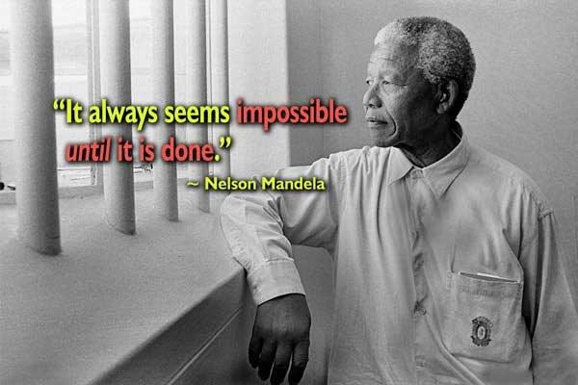

Slide 142






